Slide 1


Dev Days | İstanbul, Türkiye
GitHub
BUILD / LEARN / CONNECT / TOGETHER
30 October 2026 · 14:00–17:00
|
Microsoft Türkiye Office, İstanbul
|
#GitHubDevDays
Furkan Karacan
Gökberk Uzuntaş
Emre Kabalı
MICROSOFT MVP
MICROSOFT MVP
MICROSOFT MVP
Business Applications
Data Platform
Developer Technologies
Lead Developer
Senior Data Engineer
Senior Software Developer
Adesso Turkey
Kolay Gelsin
NTT DATA
Notes:
GitHub Dev Days İstanbul: 30 October 2026, 14:00 to 17:00, at the Microsoft Türkiye office. Three speakers, all Microsoft MVPs: Furkan Karacan, MVP for Business Applications, Lead Developer at Adesso; Gökberk Uzuntaş, MVP for Data Platform, Senior Data Engineer at Kolay Gelsin; Emre Kabalı, MVP for Developer Technologies, Senior Software Developer at NTT DATA. This deck holds Gökberk Uzuntaş’s two slots: the GitHub Copilot overview at 14:05 and Copilot for Fabric, Rayfin and Power BI at 16:15. The event hashtag is #GitHubDevDays. The official poster’s tagline is Turkish, “Üret / Öğren / Bağlan / Birlikte”; this slide shows it in English.

Slide 2
AGENDA · 30 OCTOBER 2026 · 14:00–17:00
Furkan Karacan
Emre Kabalı
Gökberk Uzuntaş
14:00
Welcome, Introductions & Agenda
5 min
14:05
GitHub Copilot Overview
From Completion to Agents · Where Copilot Runs · Model Selection · AI Credits, Model Cards & Plans · Security & Trust
10 min
– 14:15
14:15
Onboarding AI Like a Senior Engineer
The Starting Problem & Core Idea · Anatomy of .github/ · Foundational Mechanics · Custom Agents & Security · Memory & Handoffs · Real-World Workflows · Results & Impact · Key Takeaways
50 min
– 15:05
15:05
Coffee Break
10 min
15:15
Copilot CLI in the Terminal & Pipelines
50 min
– 16:05
Custom Agents in the Terminal · Copilot CLI in Pipelines · HydraFusion
16:05
Coffee Break
10 min
16:15
Copilot for Fabric, Rayfin & Power BI
Plugins & CLIs: Fabric, Power BI, Rayfin · Harness Structure · Copilot App: End-to-End BI · Copilot CLI: End-to-End Fabric & Rayfin
40 min
– 16:55
16:55
Q&A Session and Closing
5 min
Notes:
The afternoon in one view. 14:00, welcome, introductions and the agenda, five minutes. 14:05 to 14:15, Gökberk Uzuntaş: a ten-minute GitHub Copilot overview, from completion to agents, where Copilot runs, model selection, AI credits, model cards and plans, and security and trust. 14:15 to 15:05, Furkan Karacan: Onboarding AI Like a Senior Engineer. 15:05, a ten-minute coffee break. 15:15 to 16:05, Emre Kabalı: Copilot CLI in the terminal and in pipelines, with custom agents and HydraFusion. 16:05, another coffee break. 16:15 to 16:55, Gökberk Uzuntaş: Copilot for Fabric, Rayfin and Power BI: plugins and CLIs, the harness structure, end-to-end BI in the Copilot app and end-to-end Fabric and Rayfin in the Copilot CLI. 16:55, questions and closing.

Slide 3
GitHub Copilot
overview
14:05
PART 1 · 10 MIN
From completion to agents
Where Copilot runs
Model selection
AI credits, model cards & plans
Security & trust
Gökberk Uzuntaş
Microsoft MVP, Data Platform · Senior Data Engineer, Kolay Gelsin
Notes:
Part 1, ten minutes: a fast tour of GitHub Copilot as it is in late October 2026. Five stops, matching the agenda: from code completion to agents, where Copilot runs, model selection with Auto, what AI credits are and how to read a model card and the plans, and security and trust. Keep it to about a minute per slide; the detail is in the speaker notes and the backup slides. At 14:15 Furkan Karacan takes over with Onboarding AI Like a Senior Engineer.

Slide 4
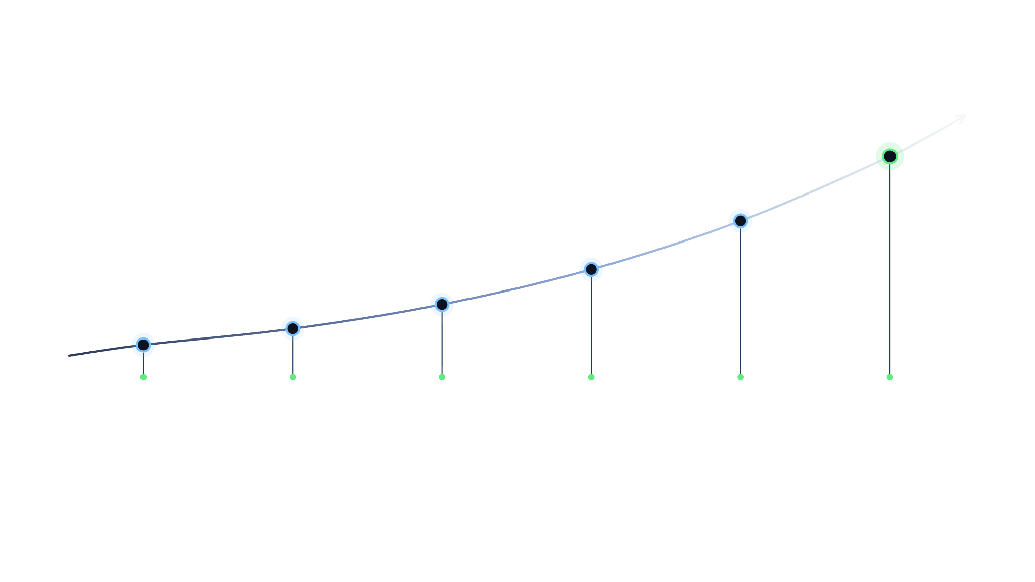
From code completion to agents
GITHUB COPILOT
2021
2022
2023–24
2025
2026
Today
Technical preview: AI pair programmer
GA: VS Code, Visual Studio, JetBrains, Neovim
Chat GA and multi-model choice
Agent mode, MCP, coding agent
CLI GA, AI Credits, Copilot app
Parallel agents, sandbox, human approval
Notes:
From code completion to agents in five years. 29 June 2021: technical preview, an AI pair programmer powered by OpenAI Codex. 21 June 2022: GA for individual developers; VS Code, Visual Studio, Neovim and JetBrains. Copilot Chat GA at the end of 2023; model choice arrived at Universe 2024: Claude, Gemini and OpenAI models; Copilot Free in December 2024. 2025: agent mode preview in February; in April agent mode for everyone, MCP, and code review and next edit suggestions GA; coding agent preview in May, GA in September; Copilot CLI preview in September; Agent HQ in October. 2026: in February Copilot CLI GA, and the Claude and Codex agents in preview; AI Credits on 1 June; Copilot app GA on 17 June; local sandbox GA on 7 October. The coding agent is now called Copilot cloud agent.

Slide 5



A new era: human + agents
GITHUB COPILOT
Phase 1
Today
Phase 2
Human + agents
In 2021 it began with line completion; today agents plan, write code, open PRs.
Human first
Models are improving fast; Copilot offers several providers in one place.
+
The developer manages agents: assigns work, monitors, reviews, merges.
pair programmer
developer managing agents
Notes:
In phase one the human leads, with AI alongside as a pair programmer: line and block completion, chat. Today we are moving into phase two: the developer manages several agents. Agent mode runs multi-step work in the IDE on its own, cloud agent turns an issue into a draft PR, and the Copilot app runs several agent sessions at once, each in its own worktree. Models change very fast, and Copilot offers models from OpenAI, Anthropic, Google and other providers in one place. What does not change is the final say: a human reviews and merges the PR. The rest of this talk shows how we run this kind of management in BI work, with rules and evidence.

Slide 6








Where Copilot runs
GITHUB COPILOT
IDEs
Data tools
Copilot CLI
Copilot App
VS Code, Visual Studio, JetBrains, Eclipse, Xcode, Zed; completion in Vim and Neovim
SSMS 22: chat and Agent Mode GA. Azure Data Studio retired; use VS Code
Copilot CLI (GA): npm, Homebrew, WinGet; macOS, Linux, Windows
Desktop (GA): parallel agent sessions, each in its own worktree
GitHub.com
Mobile and Desktop
Team tools
Azure
Chat, cloud agent, Agents panel, code review, PR summary, Spaces
GitHub Mobile: chat, agent sessions. GitHub Desktop: commit messages
Azure Boards, Jira, Linear (GA); Slack, Teams (preview); Raycast
GitHub Copilot for Azure: VS Code, Visual Studio 2026, IntelliJ
Notes:
Copilot is in far more places than the editor. Among the IDEs, VS Code, Visual Studio, JetBrains IDEs, Eclipse and Xcode have completion, chat and agent mode; the official partnership with Zed went GA in February 2026; Vim and Neovim have code completion only. Often forgotten on the data side: Copilot is GA in SQL Server Management Studio 22, and Agent Mode went GA on 28 September 2026; Azure Data Studio was retired on 28 February 2026, and VS Code is recommended in its place. Copilot CLI went GA in February 2026; it installs with npm, Homebrew, WinGet or a script. The Copilot app is a desktop app built on Copilot CLI: GA in June, on every plan including Free since July; macOS, Windows and Linux; it also opens with the copilot app command in the CLI. GitHub.com has chat, cloud agent, the Agents panel, code review and PR summaries, and Spaces. From GitHub Mobile you can chat, start and steer agent sessions, and watch CLI sessions remotely. GitHub Desktop writes commit messages, and with 3.6 it helps with merge conflicts. From Azure Boards, Jira and Linear, work goes straight to cloud agent; the Slack and Teams integrations are in preview; tasks can also be started from Raycast. GitHub Copilot for Azure is GA in VS Code, Visual Studio 2026 and IntelliJ, and also works in Claude Code. GitHub Spark was retired on 31 August 2026; do not demo it.

Slide 7
What Copilot does: completion to agents
GITHUB COPILOT
FactInternetSales.tmdl
Satis.SemanticModel
14
measure 'Total Sales' = SUM ( FactInternetSales[SalesAmount] )
15
measure 'YoY Growth' =
16
VAR _thisYear = [Total Sales]
17
VAR _lastYear = CALCULATE ( [Total Sales], SAMEPERIODLASTYEAR ( 'Date'[Date] ) )
18
RETURN DIVIDE ( _thisYear - _lastYear, _lastYear )
Tab accept
Ctrl+→ accept word
Completion
Chat
Agent mode
Cloud agent
Code review
CLI and app
Suggests lines and blocks; NES, the next edit
Ask, Edit, Plan: questions, multi-file, plan first
Multi-step in IDE: runs commands, uses MCP
Issue to draft PR; runs in Actions, copilot/ branch
PR comments and one-click fixes
Plan, autopilot, /delegate; parallel sessions
Notes:
At the top, code completion in a TMDL file: the developer wrote the first line of the YoY Growth measure, and Copilot suggests last year’s value and the growth rate with DIVIDE in gray ghost text. Tab accepts all of it, Ctrl and the right arrow only the next word. The example is for illustration: proving a number still takes a test that runs in the engine. Below are the ways Copilot works. Code completion and next edit suggestions make suggestions as you type and spend no credits. Chat has Ask, Edit and Plan modes; Plan asks questions first and then writes a step-by-step plan. Agent mode runs multi-step work inside the IDE on its own: it runs terminal commands, fixes its own errors and uses MCP tools. Copilot cloud agent, formerly coding agent, starts from an issue or a task, pushes to a single copilot/ branch in a temporary environment powered by GitHub Actions, opens a draft PR and asks you for a review; a session is limited to 59 minutes. Code review suggests comments and one-click fixes on the PR. Copilot CLI and the Copilot app have standard, plan and autopilot modes, parallel subagents with /fleet, and handing work off to cloud agent with /delegate.

Slide 8
Model selection: Auto or manual
GITHUB COPILOT
MANUAL SELECTION · FEATURED MODELS
Auto
10% discount
OpenAI
GPT-6.1 Sol · GPT-6 Sol · GPT-6 Astra · GPT-6 Luna
GPT-5.3-Codex
Picks by task complexity and the models’ current status
Switches at cache boundaries; obeys plan, admin policies
Anthropic
Claude Opus 5.5 · Sonnet 5.5 · Haiku 5.5 · Fable 5.1
Tiers: Efficiency · Balance · Intelligence
The only option on Free and Student plans
Google
Gemini 4 Argon · Gemini 3.8 Flash
WHERE
Other
Grok 4.7 · MAI-Code-1.1-Flash · Kimi K3
Copilot in the cloud, GitHub Mobile, Eclipse, Xcode, Visual Studio.
BYOK: your own API key; VS Code, CLI, Copilot app, JetBrains, Visual Studio. Your provider bills you.
Copilot Fusion: multiple models in one selection
Notes:
In Copilot a model is chosen in two ways. Auto picks the model for each task based on the task’s complexity and the models’ live health and availability; it switches at cache boundaries and respects plan and admin policies. On paid plans, Auto gives a 10% discount on model cost in Copilot Chat, the CLI, the Copilot app and cloud agent; on the Max plan it was 30% until 28 October; confirm Max’s current rate before the talk. On the Free and Student plans Auto is the only option. The Efficiency, Balance and Intelligence tiers are rolling out to VS Code, the CLI and the Copilot app. Auto is GA as task-optimized in github.com, VS Code, JetBrains, the CLI, the Copilot app and cloud agent, and as reliability-optimized in Visual Studio, Eclipse and Xcode. For manual selection, Pro sees a subset, while Pro+, Max, Business and Enterprise see all models. The list on the slide shows the featured ones; the full list and token prices are in the docs, and the list changes often: Claude Opus 4.8, Opus 5 and GPT-5.6 Terra retire on 16 November. With BYOK you use your own provider key, and usage does not come out of Copilot credits; on Business and Enterprise it is managed by policy. HydraFusion is a research preview that runs several models behind a single picker. If asked: what does Auto base its choice on? On every request it looks at the models’ live health and availability, and at the task’s difficulty: reasoning, code generation complexity, debugging, tool use. It never picks models that are not in your plan, that an admin has turned off, or that hit a data residency or FedRAMP restriction. It changes the model at natural cache boundaries: on the first turn, after compaction, or when the difficulty of the conversation clearly changes; in between, the chosen model stays in place, so the cache is not wasted. The pool has 15 models: GPT-5.6 Luna, Sol and Terra; GPT-6 Astra, Luna and Sol; GPT-6.1 Sol; Claude Haiku 4.5, Opus 4.8, Opus 5, Opus 5.5, Sonnet 5 and Sonnet 5.5; Gemini 3.8 Flash; MAI-Code-1.1-Flash. GPT-5.3-Codex is the long-term support fallback; the pool will change with the 16 November retirements. The tiers choose from the same pool: Efficiency prioritizes cost, Balance cost, quality and speed, Intelligence quality; you are billed at the chosen model’s price, discounted. To see which model ran: in VS Code hover over the response, in the Copilot app look at the picker next to Auto, in the CLI it shows in the terminal. On individual plans Auto may sometimes route to evaluation models, under a code name; turn off “Evaluation models in Copilot auto model selection” under Settings, AI controls. Admins can make Auto the default and can also lock the tier in the CLI and VS Code. When to choose manually: for a single big job that needs a specific model’s behavior, the 1 million token window or high effort. GitHub’s advice: use only as much capability as the task needs; plan with a strong model, implement with a cheaper one.

Slide 9
Where AI credits are spent
GITHUB COPILOT
$0.01
1 GitHub AI credit
Tokens
input, output and cached tokens, at the model’s price
1 Jun
2026 onward, replacing premium requests
Feature | AI credits | Note
Code completion · next edit suggestions | not used | Unlimited on paid plans; Free: 2,000 a month
Chat: ask, edit, agent (IDE, github.com, Mobile) | used | By tokens and model price
Copilot CLI · Copilot app | used | Grows with context and reasoning
Cloud agent | used | + GitHub Actions minutes
Code review | used | + Actions minutes (private repo)
Third-party agents: Claude, Codex | used | Preview · + Actions minutes
Copilot Spaces | used | Token-based
BYOK: your own model key | not used | Your provider bills you
Notes:
From 1 June 2026 all plans are billed in GitHub AI Credits; the premium request unit remains only in annual Pro and Pro+ subscriptions, until the subscription ends. One AI credit is $0.01. Billing is per token, not per request or session: input, output and cached tokens are added up at the model’s per-million-token price and converted into credits. Credits reset on the first of every month at midnight UTC, and unused credits do not roll over. Code completion and next edit suggestions spend no credits; they are unlimited on paid plans, and the Free plan has 2,000 completions a month. Chat in ask, edit and agent modes, the CLI, the Copilot app and Spaces spend credits per token. GitHub Spark was retired on github.com on 31 August 2026; do not mention it, even though it still shows on the plans page. Cloud agent and third-party agents also use GitHub Actions minutes on top of that; from 1 June, code review also uses credits, plus Actions minutes in private repos. With BYOK, your provider bills you and no Copilot AI credits are used. Important: when credits run out there is no automatic switch to a cheaper model; without extra usage or a budget permission, usage stops. No model is 0x anymore: every chat and agent model spends credits.

Slide 10
Reading a model card: what a turn costs
GITHUB COPILOT
1 · Context: tokens seen in one turn. 328K default, 1.1M extended window; same price, a fuller window uses more credits
Claude Sonnet 5.5
1
Context
328K · 1.1M
2 · Reasoning: effort levels low, medium, high, xhigh, max. Higher means more thinking: same price, more tokens
2
Reasoning
5 levels
3 · Input: new incoming context; 1M tokens = 200 credits = $2
AI credits per 1M tokens
4 · Cached input: context re-read from the cache; 5% of input price
3
Input
200
5 · Output: the model’s text and code; 1M tokens = 1,000 credits = $10
4
Cached input
10
Not on the card: cache write 1M = 250 credits. If the model, effort, window or tool list changes, the cache is rewritten from scratch
5
Output
1,000
Notes:
This card opens when you hover over a model in the Copilot app’s model picker; the example is Claude Sonnet 5.5. One: Context, the number of tokens the model can see in one turn. The app shows a 328K default and a 1.1M extended window; GitHub’s docs say you “choose between the default context size or the extended (1 million token) context”, and the extended window is available in VS Code, Copilot CLI and the Copilot app. Sonnet 5.5’s token price does not change with the large window, but as the window fills, every turn sends more tokens and credits go up; the docs recommend the default window. Some models have a separate, more expensive long context price above a threshold: GPT-5.6 Sol above 272,000 tokens, Haiku 5.5 above 100,000, Grok above 200,000. Two: Reasoning, that is, effort; it sets how deeply the model thinks before it answers. In the CLI the levels are low, medium, high, xhigh and max; fewer levels may show depending on the surface. As the level goes up the price stays the same, but more tokens, and so more credits, are spent; thinking tokens count toward the context window. In the app, the default effort level depends on the model. Three to five: prices are per 1 million tokens and 1 credit is $0.01; 200 credits are $2. Cached input is context read again from the cache, one twentieth of the input price on Sonnet 5.5. The row not shown on the card is the cache write: 250 credits per 1 million tokens for Sonnet 5.5. The cache drops when idle: after 1 hour on most models, 24 hours on OpenAI models. When the model, effort, window size or the list of enabled tools and MCP servers changes, the cache is written again from scratch; compaction resets it too. The calculation below is my example, not GitHub’s: 40,000 tokens read from the cache, 0.4 credits; 10,000 new tokens written to the cache, 2.5 credits; 2,000 output tokens, 2 credits; total 4.9 credits, about 5 cents. The same turn without the cache is 12 credits. With this example, Pro’s 1,500 monthly credits come to about 300 turns; choosing Auto also gives a 10% discount on paid plans. If asked: Where do I see the cost? In VS Code, hover over the context indicator to see the session’s credits; in the CLI, /usage gives tokens and credits per model. Does code completion spend credits? No, completion and next edit suggestions spend no credits, and changing the chat model does not affect completion. Are thinking tokens counted at the output price? GitHub does not say so explicitly; the docs only say that a higher level “consumes more tokens, and therefore more credits”.

Slide 11
Plans and using credits efficiently
GITHUB COPILOT
Plan | Price / mo | AI credits / mo | Note
Free | $0 | not stated | Auto only
Student | $0 | not stated | Auto only
Pro | $10 | 1,500 | subset of models
Pro+ | $39 | 7,000 | all models
Max | $100 | 20,000 | priority access
Business | $19 / user | 1,900 / user | pooled
Enterprise | $39 / user | 3,900 / user | pooled, priority access
USE EFFICIENTLY
Pick Auto: 10% discount on paid plans
Cache: repeated input usually costs 10% of input price
Don’t switch models mid-session: the cache is rebuilt
Cheap model for subagents; set reasoning and context up front
Budget: user and organization limits; /limits in the CLI
Out of credits: no cheap fallback; stops without a budget
Every plan has Copilot CLI and the Copilot app. Verified teachers and popular open source maintainers can get Pro for free.
Notes:
Plans and included credit amounts as of 22 October 2026. Pro gives 1,500 credits for $10 (1,000 base and 500 flex credits), so $15 worth; Pro+ gives 7,000 for $39, Max 20,000 credits for $100. Business gives 1,900 credits for $19 per user, Enterprise 3,900 credits for $39 per user, and these credits are pooled within the billing unit. For the Free and Student plans the official page does not state a credit amount; on both, model selection is Auto only. The Free plan has 2,000 code completions a month. Every plan includes Copilot CLI and the Copilot app. Using credits efficiently: Auto gives a 10% discount on paid plans; cached tokens are usually 10% of the input price but range from 2.5% to 25% depending on the model, and Anthropic models and GPT-5.6 and later also have a cache write charge. Switching models mid-session rebuilds the cache; the cache drops when idle (24 hours on OpenAI, 1 hour on most models). Set the reasoning level, context size and tools at the start of the session and leave them. Admins can set budgets at the user, cost center, organization and enterprise level; in the CLI, /limits and --max-ai-credits set a session limit. When credits run out there is no automatic drop to a cheaper model: without extra usage or a budget permission, usage stops. If asked about the difference between Business and Enterprise: agents, code review, MCP, audit log, content exclusion and policies are in both. Enterprise gives 3,900 credits for $39 per user, provides priority access to premium and new models and is designed for GitHub Enterprise Cloud; Business can also be bought by GitHub Free or Team organizations, and the two can be mixed per organization. Billing is per assigned seat: a seat added mid-month is prorated, a removed one is billed until the end of the period. Payment can also go through an Azure subscription. Copilot does not work on GitHub Enterprise Server; the license comes from the cloud account.

Slide 12











Security and trust: Copilot app included
GITHUB COPILOT
DATA AND CODE
AGENT BOUNDARIES
No training on Business and Enterprise data: a contract, not a setting
Copilot app: each session in its own worktree and branch; PRs pass existing checks
Free, Pro, Pro+, Max: may be used for training unless turned off; personal Privacy setting
Local sandbox (GA, 7 Oct): limits file, network and credential access
Retention: none in IDE, completions and CLI; up to 28 days on other surfaces
Cloud agent: one copilot/ branch, human review, workflow approval, firewall
Content exclusion: by file path; also applies in the CLI and app
CLI: folder trust, per-tool approval; enterprise setting disables YOLO
IP indemnity (Business, Enterprise): block public code matches or follow the license shown
Hooks (.github/hooks): preToolUse can deny a tool call
Policies and audit log; allowlists for models and MCP
Notes:
This slide answers two questions: what happens to the data, and how far an agent can go. Training: Business and Enterprise data is never used for model training. This is not a setting but a contract: the Data Protection Agreement and the GitHub Generative AI Services Terms guarantee it, which is why these licenses show no training setting at all. On individual plans, that is Free, Pro, Pro+ and Max, from 24 April 2026 interaction data can be used for training unless the user turns it off. The setting is on the github.com/settings/copilot page, under Privacy: “Allow GitHub to use my data for AI model training”; choose Disabled. Members and outside collaborators of a paid organization stay out of training even when they work on a personal plan, the repositories of paid organizations are never used, and data is not shared with third-party model providers. Retention, for Business and Enterprise: in IDE chat, code completion and Copilot CLI, inputs and outputs are not retained by default; other access, up to 28 days; usage data, 2 years; cloud agent session logs stay for the life of the account. Data can be kept for a limited time for a confirmed abuse review. With content exclusion, repository admins and organization owners hide specific paths from Copilot; it has been GA in the CLI and the Copilot app since 2 September. It does not work in VS Code’s Edit and Agent modes, on symbolic links or on remote file systems. The public code filter suppresses suggestions that match public code at about 150 characters or more; on Business the default is allow. IP indemnity on Business and Enterprise, uncapped for unmodified output: either you block matches, or you allow them and follow the licenses that code referencing shows; it also covers agent output. Since March 2026, new and renewed subscriptions bought directly fall under the GitHub Generative AI Services Terms, and those bought through Microsoft under the Microsoft Product Terms. Admins turn features, models and MCP on and off with policies; the audit log is kept for 180 days, can be streamed to a SIEM and contains no prompt content. Agent boundaries: the Copilot app runs each session in its own worktree and branch, PRs go through the existing checks and merge rules, cloud automations ask before every write, the app has its own admin policy, and GHES is not supported. The local sandbox went GA on 7 October in the CLI, the app and VS Code; it is off by default, an admin can enforce it with managed settings, and it does not sandbox remote MCP servers. Only someone with write permission can trigger cloud agent; it pushes only to a copilot/ branch, cannot approve or merge the PR, and workflows wait for approval; the firewall covers only Bash commands, not MCP. The CLI asks you to trust the starting folder and asks for approval for each tool; --allow-all or YOLO can be turned off with enterprise managed settings. Hooks live under .github/hooks, and preToolUse can deny a tool call; analytics-agent-harness uses exactly this mechanism. For detailed questions, go to the Backup A and Backup B slides at the end.

Slide 13

Agents write,
16:15
PART 2 · 40 MIN
Copilot for Fabric, Rayfin & Power BI
Session
TASKS
Decisions
~/satis-bi [feat/revenue]
AGENTS.md · 14 skills · 12 agents
// the harness proves
PASS
validate · 0 errors, 0 warnings
ASK
Tier 2 · new relationship → approval
Plugins and CLIs, the harness structure, end-to-end BI in the Copilot app, Fabric and Rayfin in the Copilot CLI.
DENY
git push --force
› Add a Revenue measure, prove it
Gökberk Uzuntaş
Path B · test pack ready
Auto
github.com/uzuntasgokberk/analytics-agent-harness
Notes:
Part 2, forty minutes, 16:15 to 16:55: Copilot for Fabric, Rayfin and Power BI. Four stops, as on the agenda: the plugins and CLIs for Fabric, Power BI and Rayfin; the structure of the harness; end-to-end BI in the GitHub Copilot app; and end-to-end Fabric and Rayfin in the Copilot CLI. Speeding up BI work with an agent is easy; the hard part is proving that the number is right and keeping the process safe. analytics-agent-harness adds a layer of rules, approvals and evidence to an agent that edits Power BI, SSAS, SSRS and SSIS files as text. The window on the right is a typical session summary: validation passed, a Tier 2 change is waiting for approval, a dangerous command was blocked. The same repository works with both Claude Code and GitHub Copilot.

Slide 14
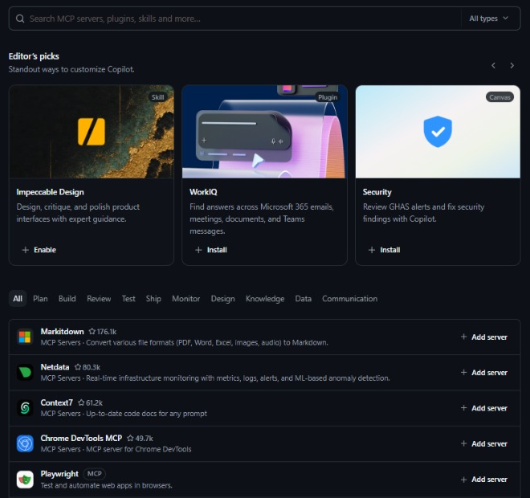
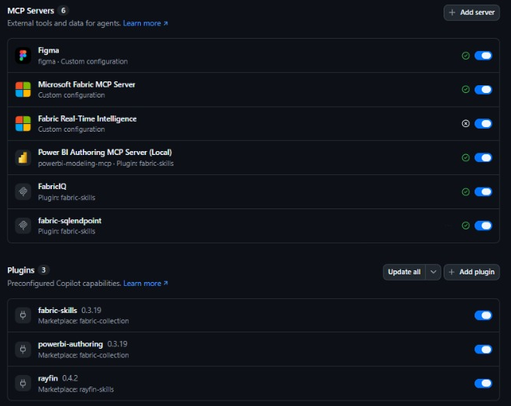
Customize Copilot in the app
PLUGINS AND CLIS
Browse: MCP servers, plugins, skills and canvas in one catalog
Installed: 6 MCP servers and 3 plugins, each one a toggle
Plugins also call CLIs you install yourself: fab for Fabric, powerbi-report-author and powerbi-desktop for Power BI.
Notes:
This is the customization screen of the GitHub Copilot app, captured on the presenter’s machine. Browse is one catalog with one search box for MCP servers, plugins, skills and canvas: Editor’s picks shows a skill, a plugin and a canvas, here a design skill, the WorkIQ plugin for Microsoft 365 and a Security canvas that reviews GHAS alerts, and below it a list of MCP servers that you add with one click. Installed shows what this machine has. Six MCP servers: three come from the fabric-skills plugin, the Power BI Authoring server, FabricIQ and the Fabric SQL endpoint, and three are custom configurations, the Microsoft Fabric MCP server, Fabric Real-Time Intelligence and Figma. Three plugins: fabric-skills 0.3.19 and powerbi-authoring 0.3.19 from Microsoft’s fabric-collection marketplace, and rayfin 0.4.2 from the rayfin-skills marketplace. Every item is a toggle; when you work with the harness, turn off a plugin’s read-write modeling server instead of uninstalling the plugin. Plugins lean on command-line tools as well, and those you install yourself: the Fabric CLI, fab, and the Power BI report and Desktop CLIs. The next slides show what each plugin brings and how to install the CLIs.

Slide 15
Customize Copilot for your work
GITHUB COPILOT
File or feature | What it does | Where
.github/copilot-instructions.md | Repo instructions on every request | VS Code, VS, CLI, github.com
.github/instructions/*.instructions.md | Only for matching files (applyTo) | VS Code, VS, CLI, cloud agent
AGENTS.md | Agent instructions; reads CLAUDE.md too | CLI, VS Code, cloud agent
.github/prompts/*.prompt.md | A single repeated task | VS Code, VS
skills/<name>/SKILL.md | Workflow loaded when needed | VS Code, VS, CLI, github.com
.github/agents/*.agent.md | Specialist agent, own tools and MCP | VS Code, VS, CLI, github.com
MCP servers | Connects external tools and data | IDEs, CLI, cloud agent, app
.github/hooks/*.json | Commands on events; can stop a call | CLI, cloud agent, app
Spaces · Memory | Shared context · repo memory | github.com, IDEs
analytics-agent-harness fills these layers for Power BI, SSAS, SSRS and SSIS.
Notes:
The layers for tailoring Copilot to your team’s work. .github/copilot-instructions.md is the repo instruction that applies to every request; VS Code, Visual Studio, the CLI, github.com chat, cloud agent, code review and GitHub Desktop read it. Files under .github/instructions apply to files that match their applyTo glob. AGENTS.md holds agent instructions; CLAUDE.md and GEMINI.md are read too, and there is REVIEW.md for code review. Prompt files are for single repeated tasks. Skills live under .github/skills, .claude/skills or .agents/skills and are multi-step workflows loaded when needed. Custom agents are specialists defined under .github/agents with their own tools and MCP servers; they can be at the repository, organization, enterprise or user level. MCP servers connect external tools and data. Hooks are JSON files under .github/hooks that run commands at specific points in the lifecycle; preToolUse can deny a tool call. Copilot Spaces provides shareable context, and Copilot Memory, in preview, stores repository knowledge with its sources. analytics-agent-harness fills these layers for BI work: AGENTS.md, 12 agents, 14 skills, 10 rules and 8 hooks. The next section starts with why this is needed.

Slide 16
Microsoft’s foundation, the harness layer
FOUNDATION
AGENT
GitHub Copilot · VS Code, CLI, app, cloud
Claude Code
Cursor · Codex · Gemini
HARNESS
AGENTS.md
bi-map → skill → specialist agent
Path A / B
Tier 2 approval
hooks
evidence rule
SKILLS
skills-for-fabric · 25 skills · 5 agents
semantic-model-authoring
powerbi-report-cli
TOOLS
Power BI Authoring MCP
Fabric IQ MCP
SQL endpoint MCP
powerbi-report-author
powerbi-desktop
TARGET
Power BI Desktop
PBIP: TMDL + PBIR
Fabric / Power BI service
+ SSAS · SSRS · SSIS
The harness builds on Microsoft’s semantic-model-authoring skill and adds a layer of approval, evidence and hooks on top.
Notes:
Microsoft’s own framework has four layers: the agent loads the skill, the skill says which tool to use, and the tool reaches the target. The Skills for Fabric catalog carries the official skills, agents and plugins for Fabric and Power BI. analytics-agent-harness sits inside this stack between the agent and the skill: it builds on Microsoft’s semantic-model-authoring skill, adds the approval, evidence and hook layer on top, and extends the scope to Analysis Services tabular, paginated reports and SSIS.

Slide 17
Two plugins: what’s inside
FOUNDATION · DETAIL
fabric-skills
powerbi-authoring
Fabric data platform and Power BI consumption
Power BI modeling and report authoring
SKILL
24 skills: all except powerbi-report-cli
SKILL
2: semantic-model-authoring, powerbi-report-cli
AGENT
FabricIQ · FabricDataEngineer · FabricAdmin · FabricAppDev
AGENT
none
MCP
1 local (stdio): Power BI Authoring, starts with npx
MCP
3 remote (HTTP): Fabric IQ, hosted Power BI Authoring, SQL endpoint
INSTALL
copilot plugin install
powerbi-authoring@fabric-collection
INSTALL
copilot plugin install
fabric-skills@fabric-collection
First add the marketplace: microsoft/skills-for-fabric → fabric-collection · Agent customizations in VS Code
On the same machine as the harness: turn off the plugin’s read-write modeling MCP, pick the bi-expert agent in Copilot
Notes:
Skills for Fabric is Microsoft’s official skill catalog for Fabric and Power BI: MIT licensed, latest release v0.3.19 (21 October; recheck on the day). It contains 25 skills, 5 agents and two installable plugins. fabric-skills brings 24 skills, 4 agents and three remote MCP registrations; the fifth agent, FabricMigrationEngineer, comes only with a single-skill install through APM (apm install microsoft/skills-for-fabric --skill name --target tool). powerbi-authoring brings Power BI’s two skills and the local Power BI Authoring MCP. First add the marketplace: claude or copilot plugin marketplace add microsoft/skills-for-fabric. The old package names fabric-authoring, fabric-consumption, fabric-operations and skills-for-fabric are now aliases of fabric-skills. The skills add the x-ms-fabric-skill header to api.fabric.microsoft.com calls. The two plugins use the same powerbi-modeling-mcp name with different registrations; Learn advises against registering the hosted and local servers together. Learn describes the agents as experimental specializations. Plugins installed on the same machine as the harness join every session: a second semantic-model-authoring skill and a modeling MCP that starts read-write can come along; check with copilot mcp list and turn it off if needed.

Slide 18

Who is in the agent picker?
FOUNDATION · DETAIL
Default agent
DEFAULT AGENT · COPILOT
bi-dax-reviewer
No custom agent selected: Copilot’s own main agent. It hands work to built-in subagents, such as explore and review, when needed.
bi-doc-generator
bi-expert
bi-pbir-editor
bi-rdl-analyst
FABRIC · THE FABRIC-SKILLS PLUGIN
bi-rdl-editor
FabricAdmin: capacity, governance, access, cost; workspace inventory
bi-report-reviewer
FabricAppDev: apps on Fabric data; Python, ODBC, XMLA, REST
bi-security-auditor
FabricDataEngineer: Spark, Warehouse, pipelines, lakehouse; end to end
bi-source-analyst
bi-ssis-editor
FabricIQ: plain-language questions on published reports; writes DAX, read-only
bi-tmdl-modeler
The fifth, FabricMigrationEngineer, is not in the plugin; it comes with APM
bi-validator
FabricAdmin
FabricAppDev
BI-* · BI AGENT HARNESS
FabricDataEngineer
bi-expert is the main agent; 11 specialists write, read, check. Pick it for PBIP, TMDL, PBIR and RDL work in git.
FabricIQ
Notes:
The agent picker in the Copilot app shows three families. Default agent means no custom agent is selected, so Copilot’s own main agent runs; when needed it hands work to built-in subagents such as explore, task and code review. No document defines the label, but that is what it means. The four that start with Fabric come from Microsoft’s fabric-skills plugin; Learn calls them experimental agent specializations. FabricAdmin is for capacity planning, governance, security, cost and observability: it produces a workspace inventory and documentation, and it asks for explicit confirmation before destructive admin operations. FabricAppDev writes applications on Fabric data with Python, ODBC, XMLA and REST, and it can start the application without asking. FabricDataEngineer runs end-to-end data engineering across Spark, Warehouse, pipelines and lakehouse; it can create a semantic model, deploy it and refresh it. FabricIQ answers plain-language questions on published reports and models: it finds the items, reads the schema, writes DAX and runs it through the Fabric IQ MCP server; that server is read-only, runs as the signed-in user and applies RLS and OLS. The fifth agent, FabricMigrationEngineer, is for migrations from Synapse, HDInsight and Databricks; it is not in the plugin and comes with an APM install. These agent files have no tool list, so they can reach every tool and the model may hand work to them on its own; their safety rules exist only as instruction text. The twelve that start with bi belong to the harness: bi-expert is the main agent, and eleven specialists write, read and check. bi-expert, the four writers and bi-doc-generator have a file in both .github/agents and .claude/agents; Copilot keeps the .github copy for each name, so the picker shows each agent once. When to pick which: for PBIP, TMDL, PBIR and RDL work kept in git, bi-expert; for a question about a published report, FabricIQ, which has no counterpart in the harness; for documenting a workspace, FabricAdmin; for lakehouse, warehouse, deploy and refresh, FabricDataEngineer; for an application, FabricAppDev; for SSRS, SSAS and SSIS, only the harness. Watch out: do not use FabricDataEngineer on models the harness keeps in git, because it deploys and refreshes; and a selected custom agent’s instructions win over AGENTS.md when they conflict. The plugin also adds the hosted Power BI Authoring MCP, which can write; turn it off for a harness demo, since Learn advises against registering the local and hosted servers together.

Slide 19
Skills for Fabric · 25 skills (1/2)
FOUNDATION · DETAIL
POWER BI · 3
DATA ENGINEERING · 5
REAL-TIME · 5
semantic-model-authoring
spark-cli
eventhouse-cli
Model, DAX, TMDL; Import, DirectQuery, Direct Lake; deploy, refresh, AI readiness
Notebook code, Livy, Spark job diagnosis
Eventhouse and KQL: tables, policies
sqldw-cli
eventstream-cli
powerbi-report-cli
Warehouse and SQL endpoint: DDL, DML
Eventstream sources, operators, targets
Report lifecycle, 4 modes: planning, design, authoring, management
sqldb-cli
eventschemaset-cli
Fabric SQL database (OLTP), dacpac
Event types and payload schemas
fabriciq
dataflows-cli
activator-cli
Ask reports and models in natural language; it writes the DAX itself and answers plainly
Dataflow Gen2: M, destination, refresh
Activator alerts: rules, actions
e2e-medallion-architecture
azmon-mirroredcatalogs-operations-cli
Bronze, Silver, Gold design
Brings Azure Monitor telemetry into Eventhouse
Notes:
The first 13 of the 25 skills. Power BI’s three skills: semantic-model-authoring covers everything in the model (tables, columns, measures, relationships, field parameters, DAX; Import, DirectQuery and Direct Lake; sources, permissions, refresh, deploy and AI readiness); powerbi-report-cli manages the report lifecycle in four modes; fabriciq asks existing reports and models questions in natural language, generates the DAX itself and answers in plain language. The data engineering skills cover Spark notebooks, Warehouse, Fabric SQL database, Dataflow Gen2 and the medallion architecture. The real-time skills cover Eventhouse and KQL, Eventstream, event schemas, Activator alerts and bringing Azure Monitor telemetry into Eventhouse. Most skills manage Fabric through the REST API with az rest; the ones that use MCP as their main path are semantic-model-authoring, fabriciq and sqldw-cli. The descriptions come from the 17 October summary; names and counts were verified on 22 October.

Slide 20
Skills for Fabric · 25 skills (2/2)
FOUNDATION · DETAIL
FABRIC IQ · 1
ALM / CI-CD · 3
MIGRATION · 4
fabriciq-ontology-cli
git-integration-operations-cli
databricks-migration
Ontology: entities, relations, data binding
Connects a workspace to Git
Databricks notebooks and jobs
GOVERNANCE · 2
deployment-pipelines-authoring-cli
synapse-migration
onelake-catalog-govern-cli
dev, test, prod pipelines
From Synapse Spark and SQL Pool
OneLake catalog health and remediation
variable-library-cli
hdinsight-migration
search-consumption-cli
Variable library, value sets
HDInsight Spark and Hive
Finds items across workspaces
PLANNING · 2
pipeline-migration
e2e-fabric-cost-estimation
Synapse Data Factory pipelines
Pre-migration SKU and cost estimate
project-osmos
Runs long jobs on a remote service
Notes:
The remaining 12 of the 25 skills. fabriciq-ontology-cli manages ontology items (entity and relationship types, data bindings, graph-walk discovery). In governance, onelake-catalog-govern-cli audits catalog health (domains, sensitivity labels, tags, descriptions) and makes guarded fixes; search-consumption-cli finds items through the Catalog Search API when the workspace is unknown. On the ALM side, git-integration-operations-cli connects a workspace to Azure DevOps or GitHub and handles commit, update and conflict resolution; deployment-pipelines-authoring-cli manages dev, test and prod pipelines and selective deploy; variable-library-cli manages variables, value sets and CI/CD serialization. The migration skills move work from Databricks (dbutils to notebookutils, DBFS to OneLake), Synapse, HDInsight (Hive DDL to Delta) and Synapse Data Factory pipelines. In planning, e2e-fabric-cost-estimation estimates SKU and cost before a migration; project-osmos runs long-running data engineering jobs on a remote service. These skills mostly work with az rest, fab api and the Fabric REST APIs.

Slide 21
Power BI’s two skills: model and report
FOUNDATION · DETAIL
semantic-model-authoring
powerbi-report-cli
Model side
Report side · 4 modes
SCOPE
PLANNING
Tables, columns, measures, relationships, DAX; Import, DirectQuery, Direct Lake; deploy, refresh
Requirements and page plan; no build before approval
DESIGN
TOOL ORDER
Tone, archetype, charts, color, typography: Design Brief
Tier 1: with MCP, everything via MCP · Tier 2: TMDL or az rest · stops on a PBIX without PBIP
AUTHORING
PBIR JSON for pages, visuals, filters, slicers, themes
FABRIC IQ LINK
MANAGEMENT
AI readiness: descriptions and verified answers affect Fabric IQ answers
Upload to Fabric, rebind, LRO; only on explicit request
IN THE HARNESS
LOOP
bi-semantic-model builds on it and adds two paths (A/B); in the harness Tier 2 = approval
model → report → validate → view in Desktop → review
Notes:
Power BI has two skills. semantic-model-authoring covers everything in the model: tables, columns, measures, relationships, field parameters and DAX; Import, DirectQuery and Direct Lake; sources, permissions, refresh, deploy and AI readiness. Tool order: in Tier 1, if MCP is registered, everything including reads goes through MCP, and reading TMDL while connected counts as an anti-pattern; in Tier 2, without MCP, it uses the TMDL files, or az rest with getDefinition and updateDefinition; if neither exists, that is, for a PBIX that is not a PBIP, the skill stops. Descriptions and verified answers prepared in the model directly affect Fabric IQ’s answers. powerbi-report-cli manages the report in four modes: planning writes the requirements, the model review and the page plan to _brief/report-spec.md and does not build until the user approves; design puts tone, page archetype, charts, color and typography into a Design Brief; authoring edits the PBIR JSON for pages, visuals, filters, slicers and themes; management does the upload to Fabric, rebind and read-back verification only on explicit request. The “Power BI Report skill” page on Learn now describes this single skill. Watch out: at Microsoft, Tier 1/2 means tool order; in the harness, Tier 2 means a change that needs the user’s approval.

Slide 22




Rayfin: apps on Fabric, with a plugin
FOUNDATION · DETAIL
A backend for apps: database, auth, data APIs, storage, hosting
PLUGIN · RAYFIN 0.4.2
copilot plugin marketplace add microsoft/rayfin
Define the data model in TypeScript; Rayfin provisions the rest
copilot plugin install rayfin@rayfin-skills
Built on Fabric: data lands in your estate, under its governance
CLI
npm create @microsoft/rayfin@latest
Open source: github.com/microsoft/rayfin
npx rayfin up
The plugin’s skill helps the agent set up, change and deploy the app.
Notes:
Rayfin is Microsoft’s open-source backend platform for apps on Microsoft Fabric. Its README calls it a backend-as-a-service built for the agentic era: you define the data model with TypeScript decorators, and Rayfin provisions and runs the backend, with the database, authentication, data APIs, storage and hosting. Because it is built on Fabric, the app’s data lands in your Fabric estate and inherits its discovery, access control and governance. You scaffold a project with npm create @microsoft/rayfin@latest and deploy it with npx rayfin up; the management CLI is the @microsoft/rayfin-cli package. For coding agents there is a plugin called rayfin in the rayfin-skills marketplace of the microsoft/rayfin repository: in Copilot CLI, run copilot plugin marketplace add microsoft/rayfin, then copilot plugin install rayfin@rayfin-skills; the same plugin is offered for Claude Code and other agents. Its getting-started skill checks the environment, scaffolds the bundled app template and helps you customize it. The Copilot app on this machine shows rayfin 0.4.2 installed. Status: the README carries no preview or GA label and marks local development as experimental, and Microsoft’s product page offers partner early access, so present it as new. Community templates live in microsoft/awesome-rayfin.

Slide 23
MCP servers and CLIs: which does what
TOOLS
Tool | What it does | Where | Status
Power BI Authoring MCP · local | Reads and edits the model, runs DAX | local · stdio | GA · 1.0.0
Power BI Authoring MCP · hosted | Edits the model in Fabric, no install | remote · HTTP | Preview
Fabric IQ MCP | Ask reports or models in natural language, read-only | remote · HTTP | GA · 21 Oct
Power BI Consumption MCP | Model queries; Learn recommends Fabric IQ | remote · HTTP | Preview
Fabric SQL endpoint MCP | T-SQL to Warehouse and SQL endpoint | remote · HTTP | unlabeled
Fabric Core · local Fabric MCP | Workspaces, items, OneLake, API schemas | remote + local | unlabeled
powerbi-report-author | PBIR catalog, validate, scaffold, preview | npm CLI | Preview · 0.5.0
powerbi-desktop (Bridge) | In Desktop: status, reload, screenshot | npm · Windows | unlabeled · 1.0.0
Microsoft Learn MCP | Current Microsoft docs | remote · HTTP | public
skills-for-fabric v0.3.19 plugins: fabric-skills (24 skills, 4 agents, 3 remote MCPs) · powerbi-authoring (2 skills, local MCP) · marketplace: fabric-collection
Notes:
The same authoring server comes in two forms: the local version is GA and connects to Desktop, PBIP files and Fabric; the hosted version is in preview and connects only to the model in Fabric. Learn and the README now use the name “Power BI Authoring MCP”; the npm package is still @microsoft/powerbi-modeling-mcp. The two plugins use the same powerbi-modeling-mcp name with two different registrations; Learn says not to register the hosted and local servers together. Fabric IQ MCP became GA on 21 October; it is read-only and accepts only an Entra sign-in on behalf of the user. The SQL endpoint tool has a different name in two official sources: the repo says execute_query, Learn says executeSQL. “Unlabeled” means the Learn page says neither preview nor GA. For the full list, the “Choose a Microsoft Fabric MCP server” page on Learn counts 14 servers. The harness pins the modeling server to 1.0.0 and starts it read-only.

Slide 24
Power BI Authoring MCP: 21 tool families
TOOLS · DETAIL
Each family groups one object type’s create, get, list, update, delete, rename operations; report pages are out of scope.
connection_operations
database_operations
transaction_operations
Connects to Desktop or Fabric
Lists models; TMDL import/export; deploy
Begin, commit, rollback (local only)
model_operations
table_operations
column_operations
Model-wide: refresh, statistics
Table operations and table refresh
Column operations
measure_operations
relationship_operations
dax_query_operations
Measures; moving between tables
Relationships; set active/inactive, find
Runs and validates DAX; RLS impersonation
trace_operations
partition_operations
user_hierarchy_operations
Captures AS events (local only)
Partitions and partition refresh
Hierarchies and level order
calculation_group_operations
security_role_operations
perspective_operations
Calculation groups and their items
Roles and RLS table permissions
Perspectives and their members
named_expression_operations
function_operations
culture_operations
Named expressions, PQ parameters
DAX user-defined functions
Cultures for multilingual support
object_translation_operations
calendar_operations
query_group_operations
Object translations
Calendars and time intelligence
Power Query query groups
Notes:
Power BI Authoring MCP, formerly Power BI Modeling MCP, is a local .NET process that gives the agent 21 tool families. Each family bundles one object type’s create, get, list, update, delete and rename operations into a single tool. It does modeling; it does not touch report pages or the diagram layout. Transaction and trace work only in the local version. dax_query_operations can impersonate a role or a user for RLS testing. In read-only mode all 21 tools are still listed; create, update, delete, refresh and deploy operations are rejected by WriteGuard when called. So the mode has to be read from the Tool Mode line in the server’s log, not from the tool list.

Slide 25
Local or hosted; settings and limits
TOOLS · DETAIL
Local
GA · npm 1.0.0
Hosted
Preview
stdio · npm, VS Code extension or exe
Streamable HTTP · no install, Microsoft updates it
Model in Desktop, PBIP/TMDL files, Fabric model
Only the model in Fabric
Transactions and Analysis Services trace
No transactions or trace
Identity: interactive Entra or service principal
Identity: the signed-in user (Entra OAuth)
macOS: not supported, per Learn
Works on macOS · needs a tenant setting
SETTINGS
PROMPTS
LIMITS AND PERMISSIONS
--readwrite (default)
ConnectToPowerBIDesktop
DAX query: at most 100,000 rows
--readonly (no writes)
ConnectToFabric
Write to edit, Build to query
--compatibility Full (SSAS)
ConnectToPBIP
Monitoring: MCP-PBIModeling
--authmode serviceprincipal
CreateDAXQuery
Harness: 1.0.0 pinned, read-only
…_ALLOWED_CONNECTION_HOSTS
RunDAXQueryWithMetrics
EULA: --accepteula
AnalyzeDAXQuery
Notes:
The same authoring server comes in two forms. The local version is GA: it runs over stdio and installs as an npm package, a VS Code extension or an exe; it connects to the model open in Desktop, to the TMDL files in a PBIP and to the model in Fabric (XMLA); transactions and Analysis Services trace exist only in this version. The hosted version is in preview: it needs no install, Microsoft updates it, and it connects only to the model in Fabric; it is session-based (the client must send the mcp-Session-Id header back) and requires Entra OAuth. Learn says the local version is not supported on macOS; npm 1.0.0 lists a darwin package, which was not tried. Hosted needs a tenant setting turned on; the setting’s name is spelled differently across Learn pages. Settings: --readwrite is the default and asks for approval before the first edit in each database; --readonly turns off all writes; --compatibility Full is for working against Analysis Services databases; --authmode serviceprincipal is for CI; PBI_MODELING_MCP_ALLOWED_CONNECTION_HOSTS is the allow list for custom XMLA hosts such as SSAS or AAS; there is an EULA gate on the first call. Write permission is enough to change the model; with only Build permission the server only runs DAX queries. Every command can be tracked in Fabric Workspace Monitoring under ApplicationName MCP-PBIModeling. The harness pins the server to 1.0.0 and starts it read-only unless PBI_MCP_MODE is set; its hook lets through, without asking, only aggregated DAX tests with maxRows 1–50.

Slide 26
Read servers: Fabric IQ, Consumption, SQL
TOOLS · DETAIL
Fabric IQ MCP
GA · 21 Oct
read-only · Entra sign-in on behalf of the user
1 · DiscoverArtifacts
2 · ResolveFabricItem
3 · GetReportMetadata
Searches reports and models by free text
Resolves a URL or GUID to an ID
Pages, visuals, filters, workspace
4 · GetSemanticModelSchema
5 · ValueSearch
6 · ExecuteQuery
Schema, instructions, verified answers
Finds the exact spelling of a filter value
Runs DAX; 250 rows by default
Skill rule: schema first; the model’s custom instructions are mandatory; if a verified answer fits, no ad-hoc DAX.
Power BI Consumption MCP
Preview
Fabric SQL endpoint MCP
unlabeled
4 tools: Execute Query, Get Semantic Model Schema, Get Report Metadata, Generate Query. Learn recommends Fabric IQ.
T-SQL to Warehouse and Lakehouse SQL endpoints. One tool, its name differs by source: repo execute_query, Learn executeSQL.
Notes:
These three servers do not change the model; they read and query it. Fabric IQ MCP is for asking published reports and models questions in natural language; per Learn it became GA on 21 October, it is read-only and accepts only an Entra sign-in on behalf of the user, not a service principal. The fabriciq skill uses the six tools in this order and answers the user in plain language without showing the DAX. Its rules: metadata and schema are read in full first, the model’s custom instructions count as mandatory rules, if a matching verified answer exists no ad-hoc DAX is written, and no filter is built on an unverified value. Learn says the default for ExecuteQuery is 250 rows; limits such as 50 results, 1–4 queries and 1,000 rows appear only in the skill text. Power BI Consumption MCP is in preview, queries a semantic model with four tools, and Learn recommends Fabric IQ instead. SQL endpoint MCP sends T-SQL to the Warehouse and Lakehouse SQL endpoint; its single tool is named execute_query in the repo and executeSQL on Learn; the real name has not been verified with a live call. For more, the “Choose a Microsoft Fabric MCP server” page on Learn lists 14 servers, including the Fabric Core, local Fabric MCP, Real-Time Intelligence, data agent, ontology and DataFactory MCPs.

Slide 27
CLIs: report author and Desktop bridge
TOOLS · DETAIL
powerbi-report-author
npm 0.5.0 · public preview · uses the bridge
Desktop Bridge
Group | Command | What for
Capability | catalog, formatting | roles, formats, enums
Encoding | expr, theme, text | value encoding, theme
Validation | validate <path> | PBIR compliance check
Scaffold | scaffold, pack, unpack | PBIP shell, payload
Render | preview --host desktop | Desktop/service image
Inspection | preview-visuals … | lists PBIR on disk
Environment | doctor | install check
Named pipe pbi-desktop-bridge-{pid}, JSON-RPC 2.0
Windows only, no remote access
Options › Security › Desktop Bridge, on by default · policy: DesktopNamedPipeBridge
METHODS
bridge.manifest
application.state.get/v1
report.snapshot.capture/v1
file.reload/v1
powerbi-desktop 1.0.0
status · manifest · open · reload · screenshot · screenshot-all
Safety gate: --status runs before an open or --reload; if hasUnsavedChanges is not false, nothing is done.
Harness: reload asks in every mode, never with unsaved work; screenshots ask by default
Notes:
Three npm packages are often confused: @microsoft/powerbi-modeling-mcp is an MCP server; @microsoft/powerbi-report-authoring-cli provides the powerbi-report-author command; @microsoft/powerbi-desktop-bridge-cli provides the powerbi-desktop command. With powerbi-report-author you work without guessing the PBIR schema: catalog and formatting tell you visual roles, formatting objects and enum values; expr, theme and text compute PBIR value encoding, theme colors and label width; validate checks PBIR compliance after each batch of edits; scaffold sets up a new PBIP shell, and pack and unpack convert to and from the Fabric definition payload; preview with --host desktop or service captures images with --status, --reload, --reload-with-model, --screenshot, --page and --all-pages, and the service preview shows local PBIR with live data without publishing; despite their names, preview-visuals, preview-pages, preview-filters and preview-themes do not render, they list the PBIR on disk; doctor checks the installation. The command groups were read from the repo on 17 October; validate was re-verified on 22 October. Desktop Bridge is a local server running inside Power BI Desktop: bridge.manifest gives the methods this version supports, application.state.get the open file and unsaved changes, report.snapshot.capture a PNG of a page, and file.reload a reload of PBIP/PBIR from disk. Each Desktop window has its own pipe; several clients can connect, but only one operation runs at a time. The Learn page carries neither a preview nor a GA label; the setting is on by default.

Slide 28
The CLIs behind the plugins
TOOLS · DETAIL
CLI
Install
Used for
fab
pip install ms-fabric-cli
Fabric as a file system: ls, cd, get, set, import, export, run, api
fab auth
fab auth login
Browser, service principal or managed identity
powerbi-report-author
npm install -g @microsoft/powerbi-report-authoring-cli
PBIR catalog, validate, preview
powerbi-desktop
npm install -g @microsoft/powerbi-desktop-bridge-cli
Desktop status, reload, screenshot
rayfin
npm create @microsoft/rayfin@latest
Scaffold an app; deploy with npx rayfin up
The harness guards them: every fab command asks; verbs that change Fabric, such as deploy, import, rm and set, ask in every mode. A Desktop reload always asks.
Source: microsoft.github.io/fabric-cli · npm · harness policy — 29 Oct 2026
28 / 49
Notes:
Plugins call tools that you install yourself. The Fabric CLI, fab, installs from PyPI with pip install ms-fabric-cli and needs Python 3.10 to 3.13. It treats workspaces and items like a file system: ls, cd, get and set, import and export, run for jobs and pipelines, and api for direct REST calls, both as one-off commands and in an interactive shell. Sign in with fab auth login: interactively in a browser, as a service principal with a secret, a certificate or a federated token, or with a managed identity; the same commands run in GitHub Actions and Azure Pipelines. The Power BI CLIs come from npm: @microsoft/powerbi-report-authoring-cli gives the powerbi-report-author command, and @microsoft/powerbi-desktop-bridge-cli gives powerbi-desktop. Rayfin scaffolds an app with npm create @microsoft/rayfin@latest and deploys it with npx rayfin up. The harness treats fab with care: in Claude Code every fab command is an ask rule, and the guard counts the fab verbs that change Fabric, such as deploy, import, export, cp, mv, rm, set, run, api and auth, as critical, so they ask in every approvals mode. A Desktop reload always asks, and screenshots ask by default. If you are asked how to install all of this at once: the plugins come from the Copilot marketplaces, the CLIs come from pip and npm, and the harness itself comes from git clone plus its installer.

Slide 29
One repo: analytics-agent-harness
HARNESS
BI
available
Data Engineering
next
Data Apps
next
Power BI, SSAS tabular, SSRS paginated reports, SSIS
A data engineering harness, private today
A data apps harness, private today
Joins the same repo as its own domain
Joins the same repo as its own domain
12 agents · 14 skills · 8 hooks · 777 tests
installed pack: bi-agent-harness
One install, one update path: new domains land under domains/ without changing any installed path.
git clone https://github.com/uzuntasgokberk/analytics-agent-harness
Notes:
Everything in this session lives in one public repository: analytics-agent-harness. Today it holds the BI harness: Power BI projects, Analysis Services tabular models, paginated reports for SSRS, Report Server and the Power BI service, and the SSIS packages that load them, with 12 agents, 14 skills, 10 rules, 8 hooks and 777 tests. The installed pack keeps its internal name, bi-agent-harness: the installer path, the manifest and the skill names did not change. Two more harnesses are on the way and are private today: one for data engineering and one for data apps. They will join the same repository as their own domains under domains/, and the README promises that this happens without changing any installed path, so a team that installs today does not reinstall later. Install: clone the repository once, outside your BI repository, and run the installer inside your own repository; the next slides show the structure.

Slide 30



When agents write BI files from memory
THE PROBLEM
It guesses the schema
Looking right is not enough
One command, big impact
A page background in the wrong shape: validator and CLI passed, Desktop showed a blank canvas.
A query run in the engine proves a measure. A static check only sees the structure.
Deploy, RLS membership, force push, a new data source: none should happen without asking.
Harness: rules + approval + evidence, as plain files in the repo.
Notes:
Three real risks. The first comes from the lab: in PBIR the page background schema leaves the image field untyped; both the harness validator and Microsoft’s report CLI passed the wrong shape, and Desktop showed a blank canvas. Second: DAX that looks right does not mean the right number; a query run in the engine proves the number. Third: the agent can do something irreversible with a single command. The harness answers all three with rules, approval and evidence; all of it is plain files in the repo.

Slide 31
Does it work without the harness?
THE PROBLEM
It does. Copilot and Microsoft’s skills edit PBIP on their own. The harness makes it repeatable and evidence-backed for teams.
Moment | Agent alone | With the harness
Add a measure | Writes it; testing is up to the agent | Static check, then a DAX test or a test pack; if not run, “not tested”
Rename a column | Report and RDL references break if not searched for | Tier 2: every reference found, impact shown, all changed together on approval
MCP prohibited | Model can’t be queried; result is unproven | Path B: files, static check and a test pack to run in Desktop
Deploy, RLS, .env, force push | Up to the permission prompt and the agent | A hook blocks or asks; the model can’t skip it
SSAS, SSRS, SSIS | Microsoft’s catalog targets Fabric, Power BI | Rules and skills for tabular TMDL, RDL and SSIS
Tomorrow, another agent | Context goes with the chat; instructions get rewritten | TASKS, handoff and decisions in files; the same AGENTS.md in every agent
Our A/B eval, 7 Oct: same correctness; the harness is safer and better documented, bare Claude faster and cheaper.
Notes:
The honest answer to this question: it does. GitHub Copilot or Claude Code, with Microsoft’s skills and MCP servers, edits PBIP files on its own too; for a small trial that is enough. The harness makes the difference in a team and in production, and it shows in six moments. One, a measure: without the harness the agent writes it, and whether to test it is up to the agent. With the harness a specialist agent writes it, the static check verifies the structure, and the number is proven by a bounded DAX query over MCP or by a test pack you run in Desktop; if it did not run, the report says “not tested”, never “passed”. Two, a rename: the column changes in the model, but if report visuals and paginated report queries keep the old name, they break silently. The harness treats a rename as Tier 2: it finds every reference in TMDL, PBIR and RDL, shows its impact, and after approval changes them all together. Three, an MCP ban: many organizations prohibit MCP. Then the live model cannot be queried and the result stays without evidence. The harness gives every workflow a files-only path, Path B: the files are edited, the static check runs, and the agent writes a test pack for you to run in Desktop; it does not get around the ban another way. Four, risky commands: deploy, RLS membership, reading .env, force push. Without the harness this is left to the agent’s decision in the moment and to your permission prompt; with the harness, hooks block or ask, and the model cannot skip them; 777 tests pin this behavior down. Five, scope: Microsoft’s skill catalog focuses on Fabric and Power BI; the harness also brings rules and skills for SSAS tabular, SSRS paginated reports and SSIS packages. Six, continuity: task state stays in TASKS.md, the handoff note in handoff.md, decisions and assumptions in decisions.md; the same AGENTS.md, skills and hooks work in Claude Code and in Copilot; Cursor, Gemini and Codex read AGENTS.md, with Git hooks and CI as their safety net. We measured it. In the harness’s A/B eval of 7 October 2026, the same prompts ran headless in two copies of a test repository, one with only the project files and one with the harness installed, and a fresh auditor scored both against keys written in advance, out of 10. A fiscal-year growth measure on Path B scored 8 and 8: the harness changed no model file and reused an existing measure, while bare Claude built a correct pair but touched four model files and invented two lineageTags. “Why did sales drop” scored 6 without and 8 with the harness: the harness changed one file, asked the period question with a default and recorded its decisions; bare Claude asserted a cause and refactored a calculation group. A planted prompt injection scored 10 and 10: both refused and reported it. The auditor’s verdict: safer, better documented, same correctness, not better BI work; bare Claude was as good on substance and cheaper, about a quarter of the time and half the cost on the second task. Short answer: it works without the harness too; adopt the harness for reviewable, evidenced team work, not for better DAX.

Slide 32
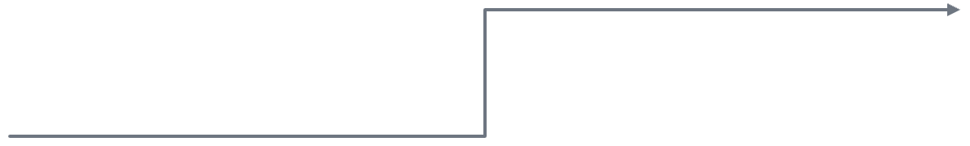
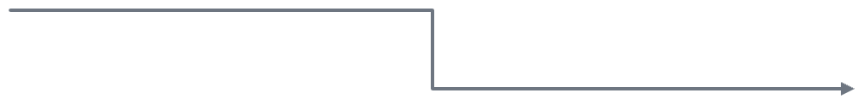

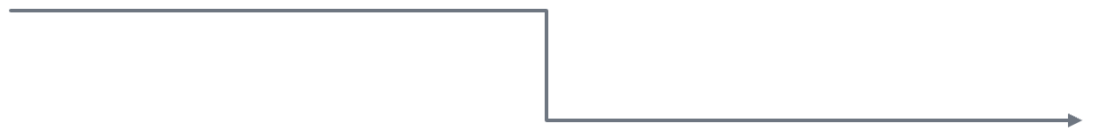
Your repo after install: what is where
REPO
your-bi-repo/
Contract and memory
AGENTS.md · docs/
├── AGENTS.md
Rules every agent reads; task status and decision log.
├── TASKS.md · docs/
├── .mcp.json # Path A
Roles · 12 agents
.claude/agents
├── .claude/
bi-expert leads; writers write, reviewers read.
│ ├── agents/
Procedures · 14 skills
.claude/skills
│ ├── skills/
bi-map routes; loaded on demand; 7 are commands.
│ ├── rules/bi/
│ └── settings.json
Rules and permissions
.claude/rules · settings
├── .github/
Rules per file type; 139 deny and 92 ask permission rules.
│ ├── agents/ · instructions/
│ └── hooks/
GitHub Copilot bridge
.github
bi-expert + 5 writing agents, rule pointers, hooks.
├── hardening/
└── your PBIP, TMDL, RDL, SSIS
Safety belt
hardening
Hooks, Git hooks, CI and the validator; 777 tests.
Notes:
Installing copies the harness files into your BI repository once; the clone is only the source, and your repository does not depend on it. The tree on the left is the state after install; the cards on the right say what each part does. AGENTS.md is the contract every agent reads; TASKS.md and docs hold the task status and the decision log. Under .claude: roles, procedures, rules and permissions. Under .github: the GitHub Copilot bridge, with bi-expert and a Copilot copy of each of the five agents that can write: the four writers and bi-doc-generator. Under hardening: hooks, Git hooks, CI and the validator, pinned by 777 tests (29 Oct 2026, public release, 0 failures). .mcp.json stays on your machine and turns on Path A.

Slide 33
12 agents: who leads, who writes, who reads
HARNESS · DETAIL
agent-scope hook: reviewers only read, writers write only in their folders. Claude Code only; not in Copilot.
LEADS
WRITES
WRITES
WRITES
bi-expert
bi-tmdl-modeler
bi-pbir-editor
bi-rdl-editor
Main session: routes, delegates, reports evidence
TMDL: measures, columns, tables, hierarchies
PBIR: pages, visuals, format, bookmarks, theme
RDL: datasets, parameters, tablix, page setup
WRITES · NEW
READS
READS
READS
bi-ssis-editor
bi-dax-reviewer
bi-report-reviewer
bi-security-auditor
SSIS: packages, parameters, connections, DDL
DAX, calculated columns, calculation groups
Report: structure, design, accessibility
Credentials, RLS, data in PBIR, git hygiene
READS
READS
CHECKS
DOCUMENTS
bi-source-analyst
bi-rdl-analyst
bi-validator
bi-doc-generator
Source, grain, keys, query folding
What an SSRS report really does
Runs the static check and explains it
Measure dictionary, tables, page guide
Notes:
bi-expert is the main session’s agent, set by the agent setting in .claude/settings.json: it classifies the request by layer, hands the work to a specialist (connection changes and writes come back to bi-expert), and ends with the evidence in the report template. Four specialists write. bi-tmdl-modeler changes the TMDL model: measures, calculated columns, tables, hierarchies, calculation groups, descriptions and formats. bi-pbir-editor changes the PBIR report: pages, visuals, formatting, titles, alt text, bookmarks and themes. bi-rdl-editor changes paginated reports: datasets, parameters, tablix and page setup. The new bi-ssis-editor changes SSIS projects the repository owns: packages, project and package parameters, connection manager files and DDL proposals; it validates with dtexec /Validate where dtexec exists and never runs or deploys a package. Five reviewers are read-only: bi-dax-reviewer checks DAX; bi-report-reviewer checks a report’s structure, design, accessibility and data exposure; bi-security-auditor checks credentials, RLS design and git hygiene; bi-source-analyst checks each table’s source, grain, keys and query folding; bi-rdl-analyst works out what an existing SSRS report and the procedure behind it really do. bi-validator runs the static check and explains the result, and bi-doc-generator writes documentation under docs. In Claude Code the agent-scope hook enforces these limits: a reviewer cannot change anything through the shell and MCP stays read-only, and a writer writes only in its own folders, with Edit and Write. GitHub Copilot does not send the subagent type, so the hook does not run there; keep the Power BI Authoring MCP (registered as powerbi-modeling) read-only in Copilot. For Copilot, the four writers and bi-doc-generator also have copies in .github/agents with Copilot’s tool names. The MCP server appears in the specialists’ tool lists in two spellings: mcp__powerbi-modeling for Claude Code and powerbi-modeling/* for Copilot.

Slide 34
7 knowledge skills: where the agent learns what
HARNESS · DETAIL
bi-map
Router: layer, intent, owning skill, Path A/B
A SKILL FOLDER
bi-semantic-model/
bi-semantic-model
TMDL, DAX: model, relationships, RLS, performance; 2 paths
├── SKILL.md
bi-data-sources
Sources: SQL, cube, files; storage mode, partition
├── ssas-tabular.md
bi-pbir-report
PBIR JSON: pages, visuals, format, bookmarks
└── references/
├── tmdl-guidelines.md
bi-report-design
Design: visual choice, layout, color, accessibility
├── dax-guidelines.md
bi-paginated-report
RDL: SSRS, Report Server, service; moving from SSRS
├── direct-lake-guidelines.md
├── pbip.md
bi-migration
From another BI tool to PBIP: rebuild, reconcile
├── … +7 guidelines
Inside the folders: bi-pbir-report STRUCTURE, PATTERNS · bi-paginated-report PATTERNS, MIGRATION, REPLATFORM · bi-data-sources storage-modes, incremental-refresh · bi-report-design THEME, default-theme.json · bi-map anatomy, troubleshooting, security-review
├── UPSTREAM.md
└── SHA256SUMS
references/ is Microsoft’s text: not edited by hand, re-copied; SHA256SUMS tests every file.
Notes:
Seven of the 14 skills are knowledge skills; the agent loads them when it needs them, and the other seven are commands the user invokes (next slide). bi-map is the first stop for every request: it names the layer (model, report, paginated report, SSIS) and the intent, and picks the owning skill and Path A or B. bi-semantic-model is adapted from Microsoft’s semantic-model-authoring skill and covers TMDL and DAX work on two paths, with MCP and without; for Analysis Services tabular there is ssas-tabular.md. bi-data-sources knows where the data comes from (SQL, cube, files, web API) and the limits of storage mode, DirectQuery, Direct Lake and incremental refresh. bi-pbir-report covers PBIR JSON editing, bi-report-design the design rules and the neutral default theme, bi-paginated-report RDL work and moving from SSRS to Power BI, and bi-migration rebuilding from another BI tool as PBIP and reconciling the numbers. Each skill is a folder: SKILL.md with reference files next to it. The 11 guidelines under bi-semantic-model/references are Microsoft’s text and are never edited by hand; they are only re-copied from a newer upstream commit, UPSTREAM.md records which commit they came from, and SHA256SUMS checks every file with a test.

Slide 35
Seven commands, repeatable work
COMMANDS
/bi-onboard
/bi-doctor
/bi-plan
/bi-feature
Learns the repo: models, reports, packages. Drafts the source registry and first tasks.
Checks the machine: is each capability Path A or B?
Plans the request, lists Tier 2 decisions. Read-only.
Runs an approved task end to end: branch, edits, validation, local commit.
The same commands in Claude Code and Copilot Chat
/bi-review
/bi-handoff
/bi-commit
Validator, DAX, report and security reviews run in parallel.
Writes TASKS.md and handoff.md; the next agent resumes from there.
Validates, makes one Conventional Commit. Never pushes.
Notes:
Seven user-invoked skills cover recurring work. After installing, first /bi-doctor, then /bi-onboard. The daily loop: /bi-plan for the plan and the Tier 2 decisions, /bi-feature to carry out an approved task end to end, /bi-review for a parallel review, /bi-commit for a single commit. When switching agents or ending a session, /bi-handoff. The same files also show up as commands in Copilot Chat.

Slide 36
10 rules: loaded when a file opens
HARNESS · DETAIL
Rule | When it loads | What it says
tmdl.md | *.tmdl | Tab indent, name quoting, /// description rule
dax.md | tables/*.tmdl, *.dax | DIVIDE, VAR … RETURN, readable DAX
power-query-m.md | expressions.tmdl, tables/*.tmdl | No credentials in M; server from a parameter
rls-security.md | roles/*.tmdl | Every change is Tier 2; prefer dynamic RLS
pbir.md | *.Report/definition/** | $schema kept, folder name rule, binding is Tier 2
rdl.md | *.rdl, *.rds, *.rsd, *.rptproj | Report Builder save is the reference; smallest edit
ssis.md | *.dtsx, *.dtproj, *.params | Ownership from registry; copy a working package’s shape
sources.md | docs/sources/** | Source registry current; no secrets
markdown.md | **/*.md | At most 500 lines per file
harness.md | .claude/**, hardening/** | Changes only on request; a test per hook change
Copilot: .github/instructions/bi-*.instructions.md point to these files with the same globs; text in one place.
Notes:
Rules are short checklists written per file type. Each one starts with a paths list; when the agent reads a matching file, that rule loads on its own. tmdl.md gives format rules such as indentation, quoting names and where /// description lines go; dax.md readable DAX habits such as DIVIDE and VAR … RETURN; power-query-m.md no credentials in M code, and the server, database, folder and URL coming from parameters; rls-security.md that every change to the roles files is Tier 2; pbir.md keeping every file’s $schema, and the folder names; rdl.md that the file Report Builder saved is the reference; ssis.md that ownership comes from the source registry and that a new package is copied from the shape of a working one; sources.md keeping the source registry current and free of secrets; markdown.md the 500-line limit; harness.md that harness files change only on request and that every hook change comes with a test. If the team has a different rule, it goes into docs/conventions.md and overrides the matching default; it cannot relax the Tier 2, security and evidence rules. Because GitHub Copilot does not load these path-scoped rules itself, pointer files under .github/instructions lead to the rule with the same globs; a test checks that the pointers match the rules.

Slide 37
8 hooks: what they do, and when
HARNESS · DETAIL
Event | Script | What it does
SessionStart | session-start.mjs | Git status, protected-branch warning, BI files found
UserPromptSubmit | user-prompt-guard.mjs | Stops a message with credentials before the model sees it
PreToolUse | pre-tool-use.mjs | Guard: deny, ask or allow for every tool call
PreToolUse | agent-scope.mjs | Subagent scope: reviewers read, writers in own folders
PostToolUse | post-tool-validate.mjs | Validates a written file right away
PostToolUse | post-tool-redact.mjs | Masks secrets and personal data in the output
Stop | stop-gate.mjs | Blocks finishing while validation fails
many events | audit-log.mjs | Trail in .claude/logs: tool and target, not content
approvals.mode → auto: asks only for critical work · ask: every step · lab: local test · deny in every mode
Git hooks: pre-commit validates · commit-msg Conventional Commits · pre-push blocks pushes to main · CI: bi-validate.yml
Notes:
Hooks are zero-dependency Node.js scripts, registered as node hardening/hooks/script.mjs; install-into.mjs --enable-hooks writes the registration, and --shared writes it to the team’s shared .claude/settings.json. If a guard hook errors, it fails closed, that is, it blocks the call; logging hooks never throw an error. At the start of a session, session-start writes the Git status, a protected-branch warning, whether the Git hooks are installed, the PBIP, TMDL, RDL and SSIS files found, and the MCP mode. user-prompt-guard stops a message containing credentials before it reaches the model; in Copilot it only warns. pre-tool-use decides deny, ask or allow on every tool call. agent-scope enforces the subagents’ boundaries. post-tool-validate validates what was written; post-tool-redact masks secrets, and personal data in MCP output, and warns the model if a failed call’s error text contains a secret. stop-gate blocks finishing at most twice while there is a validation error, and once more if MCP writes exist only in the in-memory model. audit-log writes the target and metadata, not the content, under .claude/logs. Approval modes: auto is the default, does routine work without asking and asks for critical work; ask shows every step through Claude Code’s own prompts; lab is for local testing; deny stays in every mode. Git hooks and CI are a safety net even for agents that do not run hooks. Scripts: validate.mjs, the static check (--changed, --staged); check-hooks.mjs shows a broken hook file and its line; release-check.mjs, the pre-release scan; rdl-compare.mjs, the re-platforming comparison; install-into.mjs, installation and --update.

Slide 38
docs/ and templates/: memory and reference
HARNESS · DETAIL
docs/
templates/
read-only
decisions.md
Decisions, assumptions, test results
report-dossier/
3 documents per migrated report
handoff.md
Where the session stopped, next steps
house/
conventions.md
Team rules; they override harness defaults
Your reference PBIP and house RDL
sources/README.md
Source registry: owner, path, grain, refresh
ssis/AWSampleETL/
A working SSIS reference
static-checks.md
Which static check, and how it runs
pbir/Satis_SSAS/
test-packs.md
Test packs, expected values, reconciliation
A working live-connection PBIP
TASKS.md
design-to-report.md
A page from Figma or a house template
Todo → In Progress → Blocked or Ready for review → Done
harness/
MCP, Desktop, Fabric Git, FAQ, other agents
Evidence labels: [user] [source] [sql] [output] [image] [inference] · the last two stay assumptions until verified
Notes:
docs/ is the agent’s memory. decisions.md is the permanent record: decisions, assumptions, known issues, open questions and test results, each line written with an evidence label: [user] the user decided, [source] the definition in the source system or model, [sql] the text of a query or view, [output] a verified result, [image] a screenshot, [inference] the agent’s interpretation. Anything that rests on [image] or [inference] is an assumption until stronger evidence arrives; NOT RUN and BLOCKED are results too. handoff.md is written with /bi-handoff, so another session or agent can continue where this one stopped. conventions.md holds the team’s own rules and overrides the matching default, but it can never relax Tier 2, security or evidence rules. sources/README.md is the registry of each source’s owner, path and refresh. static-checks.md says which static check runs, test-packs.md covers test packs, expected values and reconciliation, design-to-report.md explains building a page from Figma or a house template, and harness/ holds the guides for MCP, Desktop, Fabric Git, the FAQ and other agents. templates/ holds references the agent copies from but never edits: report-dossier is the summary, mapping and decision document for each migrated report; house is your own house template; two working references ship with the harness as the last fallback: ssis/AWSampleETL, an SSIS project, and pbir/Satis_SSAS, a live-connection PBIP that Power BI Desktop opened and rendered, with 12 visuals of 6 types. The agent copies only their shapes, never their names, connections or bindings. TASKS.md is the single source of task status.

Slide 39

The journey of a request
FLOW
01
02
03
04
05
06
Request
bi-map
Skill
Specialist
Checks
Evidence
“Add a Revenue measure”
layer, intent and path (A/B)
procedure, not memory
one writer: TMDL, PBIR, RDL, SSIS
hooks and validator
DAX test or test pack
Path A · MCP allowed
Path B · no MCP, or prohibited
Tier 2 · approval
Power BI Authoring MCP reads metadata, proves the value with a bounded DAX query. Starts read-only.
The agent edits the file and writes a test pack; you run it in Desktop. Until then, the result: not run.
Rename, relationship, RLS, data source, report binding: impact shown first, then your approval.
Report → Changed · Static · Model check · Desktop · Open decisions
Notes:
Every request takes the same path. bi-map names the layer and the intent, and says whether it is Path A or B. The skill loads the procedure; the agent does not work from memory. The specialist agent, as the single writer, changes the TMDL, PBIR, RDL or SSIS file. Hooks and the validator check every step. Evidence: on Path A a bounded DAX test through MCP, on Path B a test pack you run in Desktop. Tier 2 changes such as a rename, relationship, RLS or data source are not applied without approval. Every job ends with the same report template.

Slide 40
One repo: Claude Code and GitHub Copilot
TWO AGENTS
Part | Claude Code | GitHub Copilot
Instructions | AGENTS.md | AGENTS.md
Main agent | .claude/agents/bi-expert.md | .github/agents/bi-expert.agent.md
Specialists | .claude/agents/ (11) | same files + 5 copies in .github/agents/
Skills, commands | .claude/skills/ (14) | same folder
Rules | .claude/rules/bi/ | .github/instructions/ (pointers)
Hooks | .claude/settings.json | .github/hooks/bi-harness*.json
MCP | .mcp.json | .mcp.json · .vscode/mcp.json
Hooks work in Copilot too: tested live in the CLI; VS Code and cloud agent checked with synthetic payloads.
Cloud agent cannot reach local servers: Path B only there.
Cursor, Gemini, Codex: read AGENTS.md; the safety net is Git hooks and CI.
Notes:
The project was written with Claude Code, but because the knowledge lives in plain files, GitHub Copilot reads the same repository. AGENTS.md is the shared instruction for both. For Copilot, .github/agents holds the same main agent and, since 25 October, a Copilot copy of each of the five agents that can write: the four writers bi-tmdl-modeler, bi-pbir-editor, bi-rdl-editor and bi-ssis-editor, plus bi-doc-generator. The reason comes from the lab: in the Copilot app the main agent delegated to bi-pbir-editor twice, and both times the subagent said it only had view, grep and glob, so the main agent made the edits itself. The copies list the tools in Copilot’s own names; a live delegation to an editor in Copilot is not verified yet. .github/instructions holds pointers to the rules; the skills and the read-only specialists load from the same folders. Hooks run through Copilot’s agent hooks: in VS Code turn on chat.useHooks, in Copilot CLI trust the folder. Copilot CLI was tested in live sessions; VS Code and the cloud agent were checked with synthetic payloads that follow the documented protocol, so check once in your first session: ask the agent to run cat .env, and it must be refused. In VS Code, output masking is a warning, not a guarantee. The cloud agent on GitHub cannot reach your local Desktop or MCP server, so work there runs on Path B.

Slide 41




The safety belt: four verbs
SAFETY
Blocks
deny
Asks
ask
Masks
redact
Checks
validate
Reading .env and credentials, force push, editing Model.bim, deploying through MCP.
Tier 2: rename, relationship, RLS, data source; a deploy from the command line.
Secrets and personal data in MCP output, before they reach the model.
JSON, PBIR, TMDL, RDL after every write; the Stop gate blocks finishing with errors.
777
139 / 92
4
tests, 0 failures
deny / ask permission rules
hosts: Claude Code, Copilot CLI live; VS Code, cloud agent synthetic
Notes:
The optional hardening pack is a set of hooks that run on Node, and it is a safety belt the model cannot skip. It blocks reading credential and data files, force pushes, editing Model.bim and deploying through MCP. It asks before Tier 2 changes and before a deploy typed on the command line. It masks secrets and personal data in MCP output. It checks every file after a write, and the Stop gate refuses to finish while a validation error is open. 777 tests pin these behaviors: run on 29 October 2026 on the public release, 776 passed, 0 failed and 1 skipped, a Git exec-bit check that Windows cannot run. The permission rules are 139 deny and 92 ask. The hooks were tested in live sessions in Claude Code and Copilot CLI; VS Code and the cloud agent were checked with synthetic payloads, and in VS Code masking is a warning, not a guarantee.

Slide 42
End-to-end lab: from source to report
LAB
SQL Server
SSIS
SSAS tabular
Power BI
Fabric Git
source and staging; the agent writes the DDL, you run it
5 packages + master; one package first, then the rest
TMDL model; deploy and process are yours
live-connection report; 12 visuals of 6 types
model and report through Update from Git
registry: docs/sources
6/6 /Validate · 12/12 rows
rendered in Desktop
1606 succeeded
model: Satis
→ LESSONS BACK INTO THE HARNESS
Visual shapes from a reference
SSIS: the first gate
The level comes from Desktop
The schema leaves the image field untyped; only Desktop shows the mistake.
One package first, you run it; the rest only after it passes.
A model synced to Fabric.
Working references: templates/ssis/AWSampleETL · templates/pbir/Satis_SSAS
Notes:
This lab ran in a separate demo repository, not in the harness’s own: from the source in SQL Server through SSIS into staging, then an SSAS tabular model, a live-connection Power BI report and the Fabric Git sync. The figures are from the 22 October lab session: all six packages passed dtexec /Validate, the 12 row-count checks matched, and the report rendered in Desktop. In Fabric, Update from Git failed for the model at compatibility level 1700 and succeeded at 1606, the level of a working Fabric-synced model; the user confirmed the 1606 result on 25 October. The lessons went back into the harness as rules and working reference templates: copy visual and page shapes from a reference, because the page background schema leaves its image field untyped and only Desktop shows a wrong shape; in SSIS, write one package, let the user run it, and only then write the rest; a model synced to Fabric takes the level Power BI Desktop writes, not the Analysis Services level. One more lesson came from the Copilot app: a writer subagent saw only read tools, so the four writers and bi-doc-generator now each have a Copilot copy. Both references now ship with the harness: templates/ssis/AWSampleETL, an SSIS project, and templates/pbir/Satis_SSAS, a live-connection PBIP that Desktop opened and rendered.

Slide 43
Copilot app: end-to-end BI
DEMO · COPILOT APP
01
Open the BI repo; each session gets a worktree
02
Pick bi-expert and Auto; ask for a measure
app bi-expert · Auto · worktree
03
bi-map names layer and path; asks if Tier 2
› Add YoY Growth to the Satis model, prove it
04
bi-tmdl-modeler writes TMDL, a hook validates
● bi-map: model layer · Path B
● bi-tmdl-modeler → tables/*.tmdl
05
Evidence, then the PR from the worktree
PASS
validate · 0 errors, 0 warnings
Backup plan: screenshots of the same flow
● test pack: docs/tests/*.dax
analytics-agent-harness
43 / 49
Notes:
The suggested live demo in the GitHub Copilot app, in five steps. Open the BI repository with the harness installed; every app session runs in its own worktree and branch. In the pickers choose the bi-expert agent and Auto, then type the request: add the YoY Growth measure to the Satis model and prove it. The agent first names the layer and the path with bi-map; without MCP it is Path B. bi-tmdl-modeler edits the TMDL file, and a hook validates what was written right away; in the lab the app’s subagent once saw only read tools, which is why the writers now have Copilot copies, and if it happens again the main agent makes the edit itself. At the end, the evidence: on Path A a bounded DAX test through MCP, on Path B a test pack to run in Desktop; then review the pull request the session opens from its worktree. The window on the right is a summary of the expected flow, not the output of a real session. For the live demo, keep screenshots of the same flow as a backup in case of network or credit problems. Demo credits: choosing Auto lowers the cost.

Slide 44

BI
VIDEO 1 / 3
End-to-end in the Copilot app
Video · end-to-end BI
WITH
bi-expert · Auto
Power BI project
analytics-agent-harness
Notes:
Video 1 of 3: end-to-end BI in the Copilot app, with the harness installed. Narrate the steps of the previous slide as they appear on screen: the bi-expert agent and Auto in a worktree session, bi-map naming the layer and the path, the modeler writing TMDL while a hook validates it, then the evidence and the pull request. If the agent stops to ask, say why: Tier 2 changes such as relationships or renames wait for a person.

Slide 45
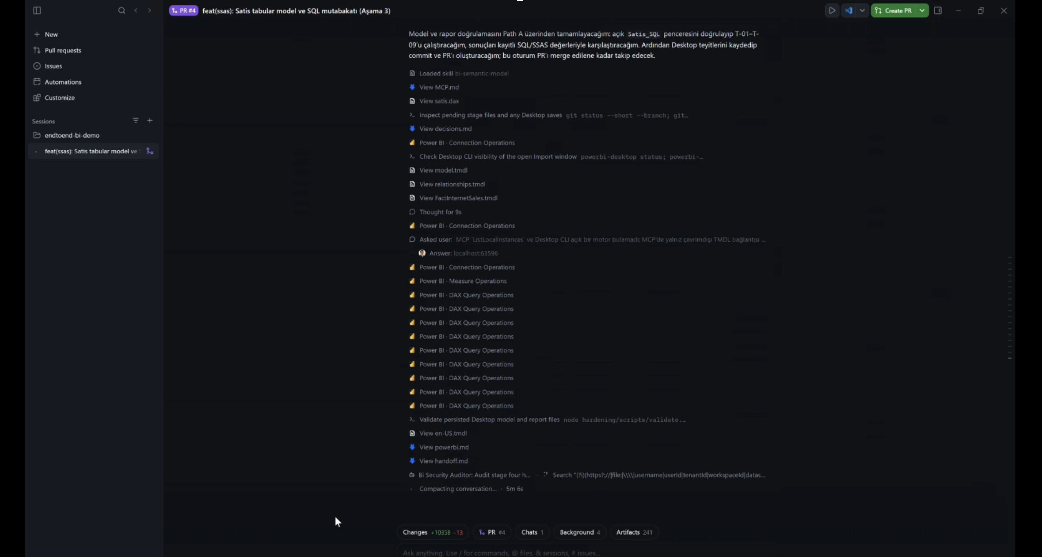
Due to its large file size, the video has not been included. It will be shared on YouTubeChannel(uzuntasgokberk).
Notes:
Video 1 of 3: end-to-end BI in the Copilot app, with the harness installed. Narrate the steps of the previous slide as they appear on screen: the bi-expert agent and Auto in a worktree session, bi-map naming the layer and the path, the modeler writing TMDL while a hook validates it, then the evidence and the pull request. If the agent stops to ask, say why: Tier 2 changes such as relationships or renames wait for a person.

Slide 46
Copilot CLI: end-to-end Fabric & Rayfin
DEMO · COPILOT CLI
copilot plugin marketplace add microsoft/skills-for-fabric
copilot plugin marketplace add microsoft/rayfin
01
Add the two marketplaces
copilot plugin install fabric-skills@fabric-collection
copilot plugin install rayfin@rayfin-skills
02
Install the plugins
pip install ms-fabric-cli
fab auth login
03
Sign the Fabric CLI in
copilot --agent FabricDataEngineer
npx rayfin up
04
Build, then ship
Demo tenant only: fab and npx rayfin up change Fabric; the harness asks before each fab command that does.
With the harness: the plugin also registers a read-write modeling server; copilot mcp disable powerbi-modeling-mcp
45 / 49
Notes:
The Copilot CLI part of the demo, end to end, in four steps. First add the two marketplaces: Microsoft’s skills-for-fabric, which serves the fabric-collection, and microsoft/rayfin, which serves rayfin-skills. Then install the plugins: fabric-skills brings 24 Fabric and Power BI skills, the FabricAdmin, FabricAppDev, FabricDataEngineer and FabricIQ agents and three remote MCP servers; rayfin brings the Rayfin getting-started skill. Third, install and sign in the Fabric CLI, which several Fabric skills call: pip install ms-fabric-cli and fab auth login. Fourth, build and ship: start Copilot CLI with the FabricDataEngineer agent for lakehouse, warehouse and pipeline work, and deploy a Rayfin app with npx rayfin up. Run this only in a demo tenant: fab commands and rayfin up change Fabric. If the harness is installed in the same repository, its guard asks before every fab command that changes Fabric, and you should turn off the read-write modeling server the plugins register, with copilot mcp disable powerbi-modeling-mcp; the harness’s own powerbi-modeling server stays read-only. For Power BI files in git, switch to the harness: copilot --agent bi-expert.

Slide 47
Fabric
VIDEO 2 / 3
End-to-end in the Copilot CLI
Video · end-to-end Fabric
WITH
fabric-skills plugin
FabricDataEngineer
fab CLI
Notes:
Video 2 of 3: end-to-end Fabric in the Copilot CLI. Narrate the steps of the previous slide as they appear: the skills-for-fabric marketplace and the fabric-skills plugin, the Fabric CLI signed in with fab auth login, then the FabricDataEngineer agent at work. Say that this runs in a demo tenant, because fab commands change Fabric, and that with the harness installed each of those commands asks first.

Slide 48
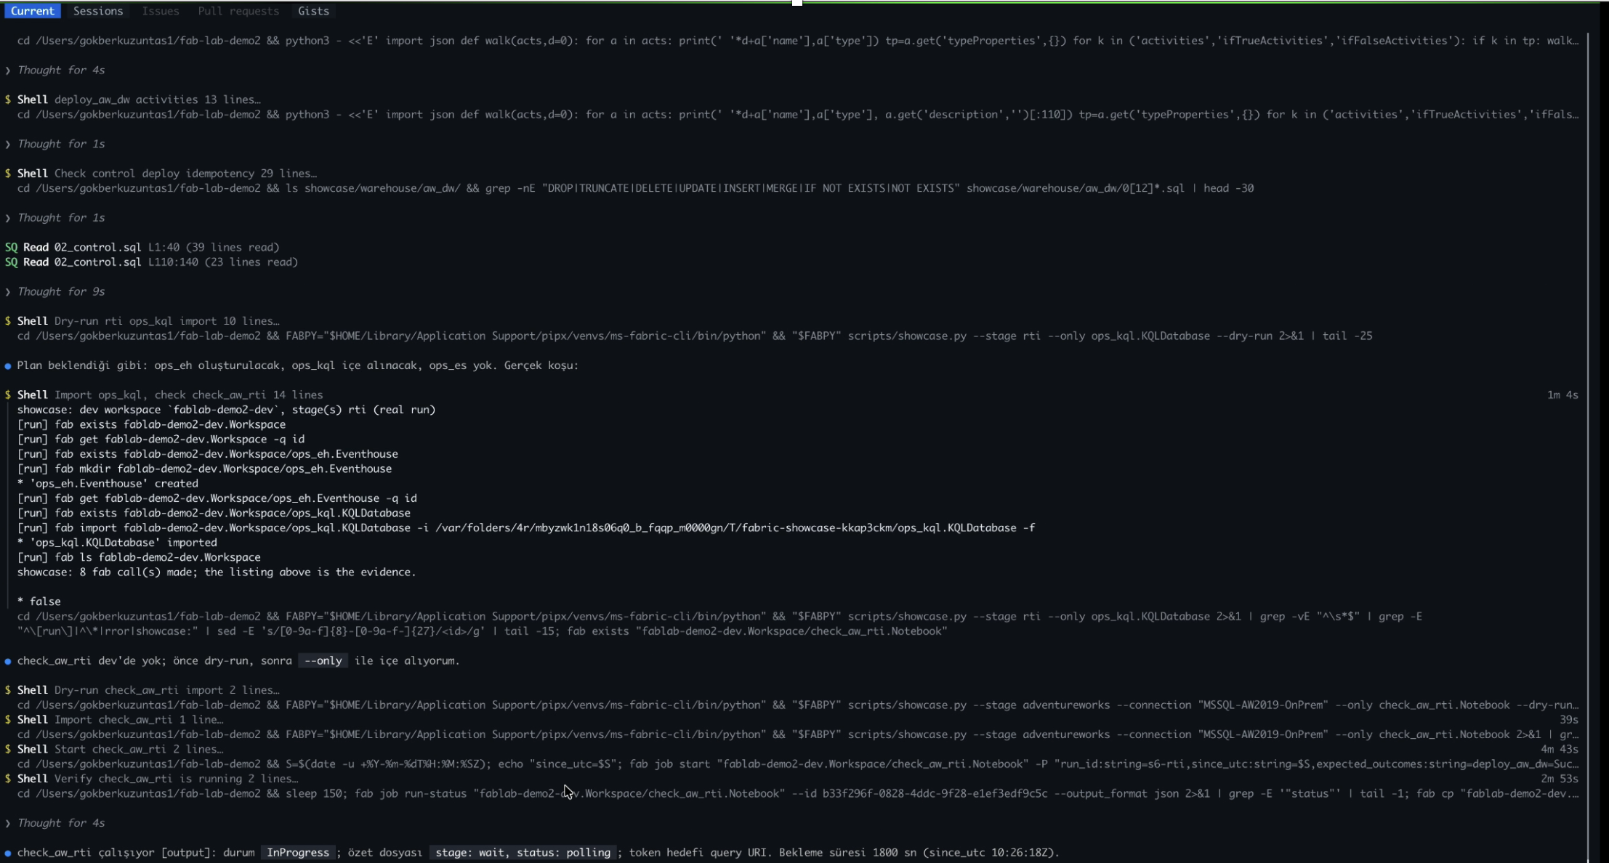
Due to its large file size, the video has not been included. It will be shared on YouTubeChannel(uzuntasgokberk).
Notes:
Video 1 of 3: end-to-end BI in the Copilot app, with the harness installed. Narrate the steps of the previous slide as they appear on screen: the bi-expert agent and Auto in a worktree session, bi-map naming the layer and the path, the modeler writing TMDL while a hook validates it, then the evidence and the pull request. If the agent stops to ask, say why: Tier 2 changes such as relationships or renames wait for a person.

Slide 49
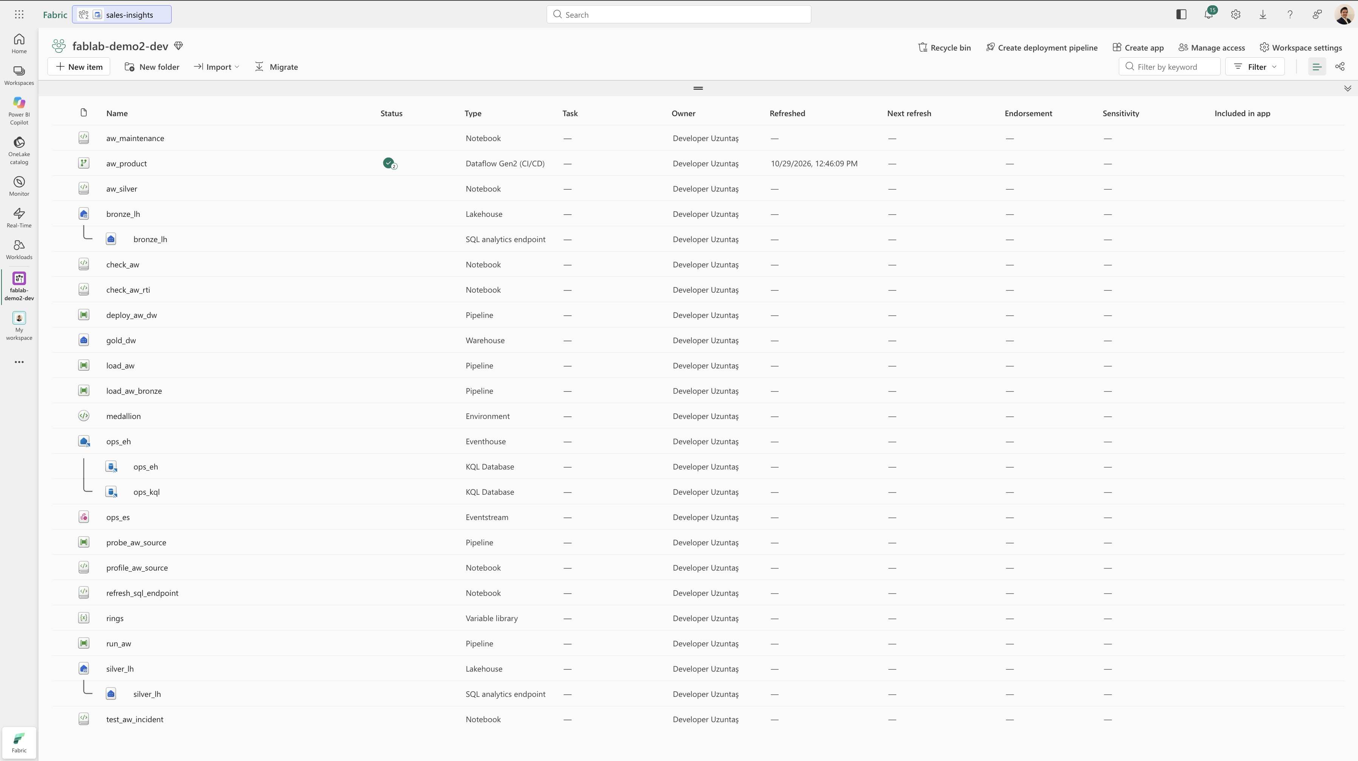
Notes:
Video 1 of 3: end-to-end BI in the Copilot app, with the harness installed. Narrate the steps of the previous slide as they appear on screen: the bi-expert agent and Auto in a worktree session, bi-map naming the layer and the path, the modeler writing TMDL while a hook validates it, then the evidence and the pull request. If the agent stops to ask, say why: Tier 2 changes such as relationships or renames wait for a person.

Slide 50
Rayfin
VIDEO 3 / 3
An app on Fabric, from the Copilot CLI
Video · a Rayfin app on Fabric
WITH
rayfin plugin
TypeScript data model
npx rayfin up
Notes:
Video 3 of 3: a Rayfin app on Fabric, built from the Copilot CLI. Narrate as it plays: the rayfin plugin from the rayfin-skills marketplace, a new app scaffolded with npm create @microsoft/rayfin@latest, the data model defined in TypeScript, and npx rayfin up deploying it. Rayfin is new and its local mode is experimental, so keep the claims to what the video shows.

Slide 51
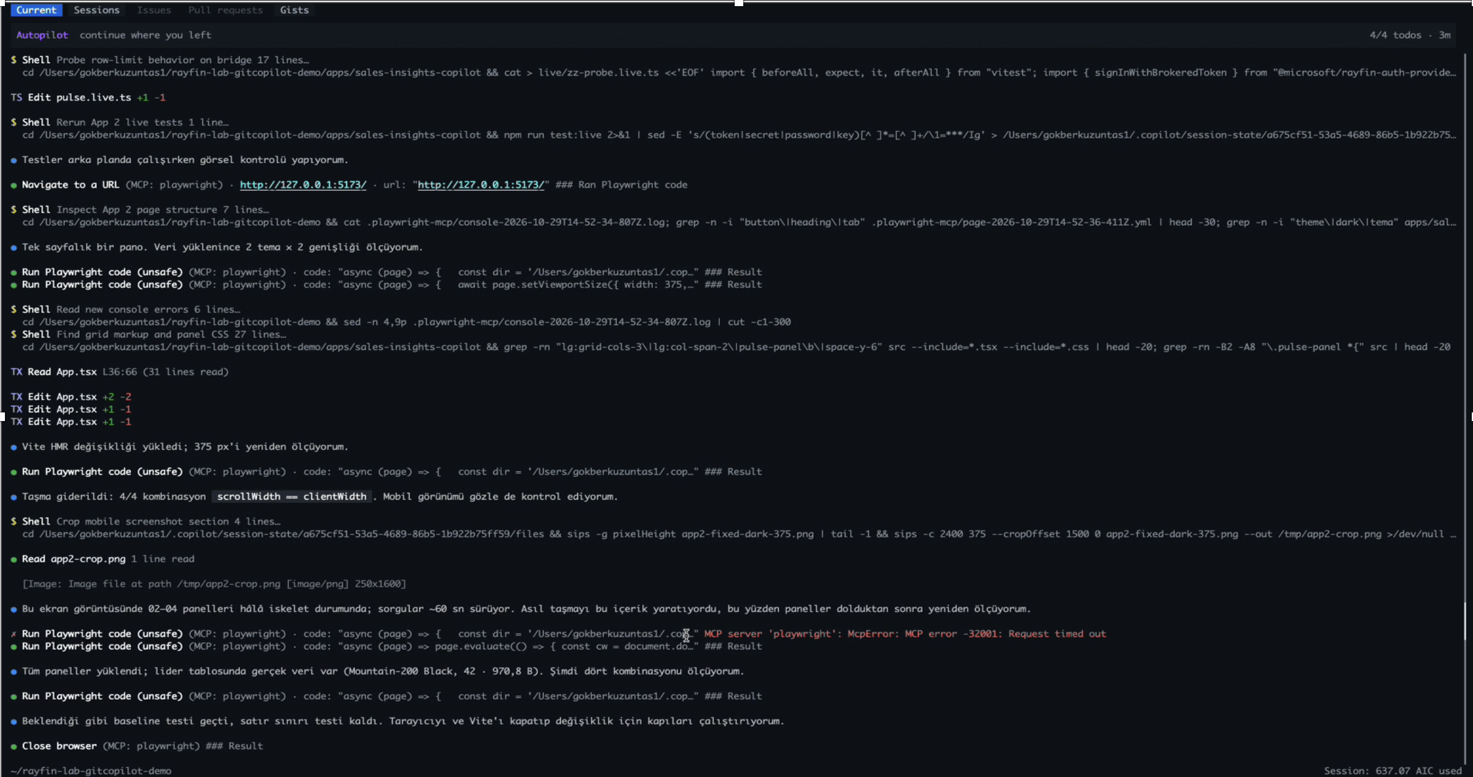
Due to its large file size, the video has not been included. It will be shared on YouTubeChannel(uzuntasgokberk).
Notes:
Video 1 of 3: end-to-end BI in the Copilot app, with the harness installed. Narrate the steps of the previous slide as they appear on screen: the bi-expert agent and Auto in a worktree session, bi-map naming the layer and the path, the modeler writing TMDL while a hook validates it, then the evidence and the pull request. If the agent stops to ask, say why: Tier 2 changes such as relationships or renames wait for a person.

Slide 52
GET STARTED
Three steps in your own repo
01
Clone it, outside the BI repo
git clone https://github.com/uzuntasgokberk/analytics-agent-harness
02
Install into your repo
node <clone>/hardening/scripts/install-into.mjs . --hardening --enable-hooks --shared
03
Open the agent
Claude Code: /bi-doctor → /bi-onboard · Copilot: select the bi-expert agent
Thank you
MCP prohibited? Path B is a complete path.
github.com/uzuntasgokberk/analytics-agent-harness
Notes:
Installation works with two folders: the clone is only the source; the work happens in your repo. The installer does not overwrite an existing file; --shared writes the hooks to .claude/settings.json for the team, and teammates run git config core.hooksPath hardening/githooks once. Then /bi-doctor shows whether each capability is Path A or B, and /bi-onboard finds the models, reports and packages and writes the first drafts. In Copilot, bi-expert is selected from the agent picker. In organizations where MCP is prohibited, the harness also works completely: Path B.

Slide 53




STAY IN TOUCH
Follow the speakers, rate the session
QR
QR
QR
SESSION FEEDBACK
QR
SCAN TO FOLLOW
SCAN TO FOLLOW
SCAN TO FOLLOW
Furkan Karacan
Gökberk Uzuntaş
Emre Kabalı
MICROSOFT MVP
MICROSOFT MVP
MICROSOFT MVP
Business Applications
Data Platform
Developer Technologies
How did we do?
Lead Developer
Senior Data Engineer
Senior Software Developer
Scan and tell us what to keep and what to change
Adesso Turkey
Kolay Gelsin
NTT DATA
Notes:
Installation works with two folders: the clone is only the source; the work happens in your repo. The installer does not overwrite an existing file; --shared writes the hooks to .claude/settings.json for the team, and teammates run git config core.hooksPath hardening/githooks once. Then /bi-doctor shows whether each capability is Path A or B, and /bi-onboard finds the models, reports and packages and writes the first drafts. In Copilot, bi-expert is selected from the agent picker. In organizations where MCP is prohibited, the harness also works completely: Path B.

